Slide 1
Understanding Financial Performance
Getting on Track Authors: Rodney L. Sharp, John P. Hewlett, Jeffrey E. Tranel
Notes:
Audio:
Welcome to Getting on Track: Understanding Financial Performance. In this course you will learn how to analyze the health of your business using financial ratios.
Click the next arrow to start at the beginning of the course or click the Menu link to select a lesson from the Main Menu. We recommend that you view the lessons in order the first time through the course.

Slide 2
Introduction
Lesson 1

Slide 3
Introduction
Meet Jack and Joanie
The Business | The Family
Family farm with sheep and cut flower enterprises. In business 15 years. Run by Joanie with occasional hired help. | Jack and Joanie; married 20 years. Two daughters; Jennifer, 16 , and Julie, 14. Joanie’s father is a retired loan officer who has provided Jack and Joanie with financial guidance and assistance in managing the business.
Notes:
Audio:
Fifteen years ago Jack and Joanie started a farming enterprise to allow Joanie to stay at home with their children.
They started the business with a small cut flower enterprise and a couple of sheep. Over the years, they have significantly expanded both the flower and sheep enterprises.
Jack and Joanie have two daughters. Jennifer just turned sixteen and is beginning to think about going off to college. Julie is 14 and about to start high school.

Slide 4
Introduction
Changing Times, Changing Needs
Notes:
Audio:
Jennifer has been looking for a job that will help her to earn some money for college.
The family farm has expanded to the point that at certain times of the year it is hard for Joanie to manage it all without some hired help.
Joanie approaches Jack with an idea.

Slide 5
Introduction
Changing Times, Changing Needs
Why don’t we hire Jen and Julie to work on the farm rather than having them find jobs somewhere else? I could use the help.

Slide 6
Introduction
Changing Times, Changing Needs
It’s a nice idea, but I’m not sure that the business can support two part-time employees on an ongoing basis.

Slide 7
Introduction
Financial Records
Jack and Joanie know that their financial records are complete and accurate by:
Keeping all business receipts.
Recording business income and expenses in a journal.
Summarizing all journal entries in a monthly ledger.
Developing an income statement from the monthly ledger to estimate profitability.
Categorizing the information by enterprise to determine which combination of enterprises provides the greatest opportunity for profitability.
Notes:
Audio:
When Jack and Joanie started their business, Joanie’s father helped them set up some financial records.
Jack and Joanie have been keeping financial records ever since that time.

Slide 8
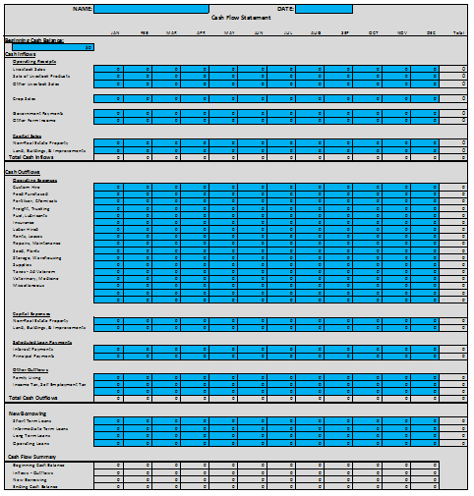
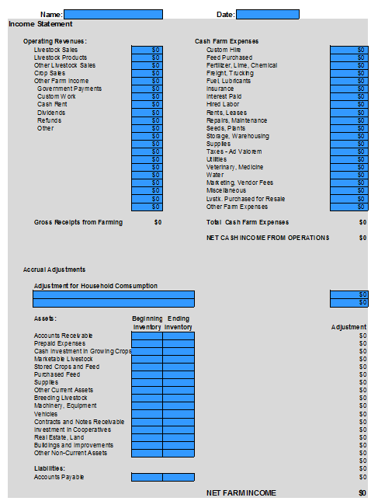
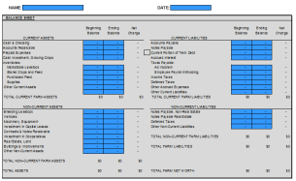
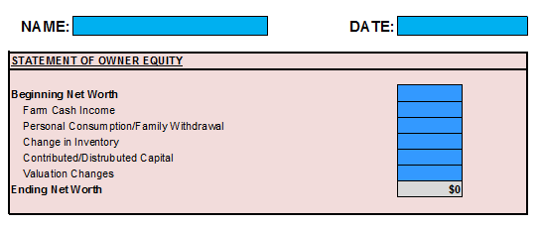
Introduction
Financial Statements
The financial statements that Jack and Joanie created include:
Cash flow statements
Balance sheets
Income statements
Statements of owner equity
These statements help them to determine whether the business is generating equity growth and net farm income.
If you are not familiar with financial statements, you should review the course, Getting on Track: Better Management through Financial Statements.
Notes:
Audio:
Dad also taught Jack and Joanie how to use their financial records to develop a set of financial statements for the business each year.
These statements help them to determine whether the business is generating equity growth and net farm income.

Slide 9
Introduction
Financial Statements
The financial statements that Jack and Joanie created include:
Cash flow statements.
Balance sheets.
Income statements.
Statements of owner equity.
These statements help them to determine whether the business is generating equity growth and net farm income.
If you are not familiar with financial statements, you should review the course, Getting on Track: Better Management through Financial Statements.
Equity is the part of the assets you own. For example, your equity in the ranch is the value of the ranch assets less the amount you owe. Equity is also known as “net worth”.

Slide 10
Introduction
Financial Statements
The financial statements that Jack and Joanie created include:
Cash flow statements.
Balance sheets.
Income statements.
Statements of owner equity.
These statements help them to determine whether the business is generating equity growth and net farm income.
If you are not familiar with financial statements, you should review the course, Getting on Track: Better Management through Financial Statements.
Net Farm Income is the amount of revenue remaining after operating expenses have been paid.

Slide 11
Introduction
Financial Analysis
Notes:
Audio:
Despite all the financial information available to Jack and Joanie, they are not sure how to use it to determine the financial health of their business and their ability to take on additional employees.
Joanie suggests that they call her Dad for some advice.

Slide 12
Introduction
Financial Analysis
Dad, how can we use our financial information to make business decisions?

Slide 13
Introduction
Financial Analysis
For example, like whether we can afford to hire the girls as part-time help.

Slide 14
Introduction
Financial Analysis
It sounds like you two need to begin doing some basic financial analysis.

Slide 15
Introduction
In This Course
You will learn:
Five key indicators of financial health.
How to assess financial health using financial ratios.
How to calculate a variety of financial ratios.
Ratios parameters that indicate strength or weakness.
Actions for improving financial performance in the five key areas.
Notes:
Audio:
In this course you will follow Jack and Joanie as they learn how to analyze financial performance.
You will learn about five key indicators of financial health and how to assess them using financial ratios.
You will learn how to calculate a variety of ratios as well as the parameters that indicate financial strength or weakness. You will also receive some suggestions for actions you can take to improve financial performance in each of the five key areas.

