Slide 1
Understanding Financial Performance
Getting on Track Authors: Rodney L. Sharp, John P. Hewlett, Jeffrey E. Tranel
Notes:
Audio:
Welcome to Getting on Track: Understanding Financial Performance. In this course you will learn how to analyze the health of your business using financial ratios.
Click the next arrow to start at the beginning of the course or click the Menu link to select a lesson from the Main Menu. We recommend that you view the lessons in order the first time through the course.

Slide 2
What is Financial Analysis?
Lesson 2

Slide 3
What is Financial Analysis?
Are You Healthy?
What is financial analysis? How is it different from creating and reviewing our financial statements?

Slide 4
What is Financial Analysis?
Are You Healthy?
In financial analysis, you use the values on your financial statements to assess your financial health much like a doctor uses your vital signs to assess your physical health.

Slide 5
What is Financial Analysis?
Are You Healthy?
Notes:
Audio:
When you go to the doctor for a check-up, they gather information; such as your blood pressure, your temperature, your pulse, and any other information they deem necessary for determining your medical health.
Each vital sign has some general guidelines of what the measure should be. For example, the temperature for a healthy adult should be between 97.8 and ̊ 99.1F.
Anything outside this range might indicate a potential health problem. It does not indicate what the problem is, but gives the doctor and patient an indicator that some action may be necessary.

Slide 6
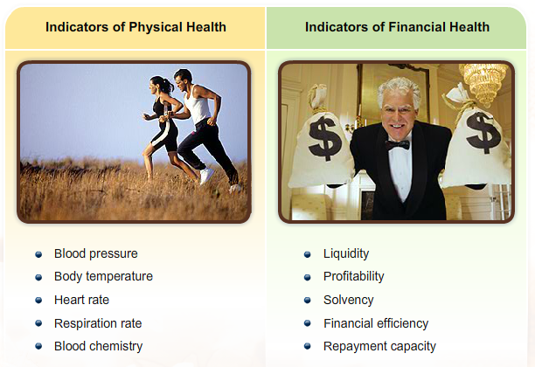
What is Financial Analysis?
Are You Healthy?
Notes:
Audio:
The process is similar for analyzing financial performance. In financial analysis producers assess the business’s financial health and chart its progress. The analysis identifies any strengths and weaknesses and where action may be necessary to correct a problem.

Slide 7
What is Financial Analysis?
Why Do Financial Analysis?
Financial analysis provides information that can be used in different ways by different individuals.
Click on the images below to see how these individuals use information from financial analysis
What can we learn about the business by doing financial analysis?

Slide 8
What is Financial Analysis?
Why Do Financial Analysis?
Financial analysis provides information that can be used in different ways by different individuals.
Click on the images below to see how these individuals use information from financial analysis
Financial analysis provides information that can be used in a variety of ways.

Slide 9
What is Financial Analysis?
Why Do Financial Analysis?
Financial analysis provides information that can be used in different ways by different individuals.
Click on the images below to see how these individuals use information from financial analysis
Notes:
Audio:
The information that can be gleaned from financial analysis is useful to different people in different ways. Click on the images to see how different individuals use information from financial analysis.

Slide 10
What is Financial Analysis?
Why Do Financial Analysis?
Financial analysis provides information that can be used in different ways by different individuals.
Click on the images below to see how these individuals use information from financial analysis
Farm Manager

Slide 11
What is Financial Analysis?
Why Do Financial Analysis?
Financial analysis provides information that can be used in different ways by different individuals.
Click on the images below to see how these individuals use information from financial analysis

Slide 12
What is Financial Analysis?
Why Do Financial Analysis?
Financial analysis provides information that can be used in different ways by different individuals.
Click on the images below to see how these individuals use information from financial analysis

Slide 13
What is Financial Analysis?
What Should We Measure?
The Farm Financial Standards Council recommends five categories of measurement for financial analysis.
Click the tabs to learn about each category.
Ok, we’re convinced that financial analysis is a good idea, but how will we know what to measure?
Notes:
Audio:
In 1990 a group of industry experts began working together to promote uniformity in financial reporting and analysis for agriculture. This group, now called the Farm Financial Standards Council, developed Financial Guidelines for Agricultural Producers. The recommended measures were categorized into five broad categories: Liquidity, Solvency, Profitability, Financial Efficiency, and Repayment Capacity.
Click the tabs to learn more about these categories.

Slide 14
What is Financial Analysis?
What Should We Measure?
The Farm Financial Standards Council recommends five categories of measurement for financial analysis.
Click the tabs to learn about each category.

Slide 15
What is Financial Analysis?
What Should We Measure?
The Farm Financial Standards Council recommends five categories of measurement for financial analysis.
Click the tabs to learn about each category.

Slide 16
What is Financial Analysis?
What Should We Measure?
The Farm Financial Standards Council recommends five categories of measurement for financial analysis.
Click the tabs to learn about each category.

Slide 17
What is Financial Analysis?
What Should We Measure?
The Farm Financial Standards Council recommends five categories of measurement for financial analysis.
Click the tabs to learn about each category.

Slide 18
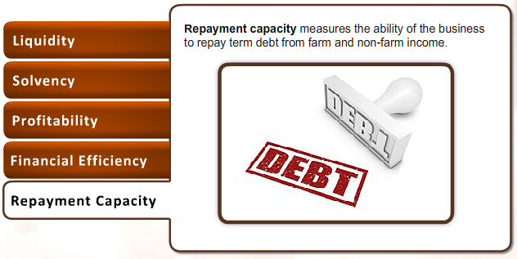
What is Financial Analysis?
What Should We Measure?
The Farm Financial Standards Council recommends five categories of measurement for financial analysis.
Click the tabs to learn about each category.

Slide 19
What is Financial Analysis?
Financial Ratios
There are hundreds of different financial ratios. Each one indicates a different aspect of financial health.
Smart business managers focus on only a few that are key to the success of their business.
The Farm Financial Standards Council recommended 21 formulas for measuring the financial viability of farm and ranch operations
How do we measure liquidity, solvency, profitability, financial efficiency, and repayment capacity?

Slide 20
What is Financial Analysis?
Financial Ratios
There are hundreds of different financial ratios. Each one indicates a different aspect of financial health.
Smart business managers focus on only a few that are key to the success of their business.
The Farm Financial Standards Council recommended 21 formulas for measuring the financial viability of farm and ranch operations
You measure these things by calculating financial ratios. Financial ratios indicate the relationship between different values found on your financial statements.

Slide 21
What is Financial Analysis?
Financial Ratios
There are hundreds of different financial ratios. Each one indicates a different aspect of financial health.
Smart business managers focus on only a few that are key to the success of their business.
The Farm Financial Standards Council recommended 21 formulas for measuring the financial viability of farm and ranch operations
Notes:
Audio:
There are hundreds of financial ratios that can be calculated.
You can easily become overwhelmed by the number and variety of ratios to choose from. Smart business managers focus on only a few that are key to the success of their businesses.
The Farm Financial Standards Council recommended 21 formulas for measuring the financial viability of farm and ranch operations.
In the following lessons you will learn 11 of these formulas to help you get started with financial analysis. As you become more comfortable with the process, you should include the additional measures that are recommended as well.

Slide 22
What is Financial Analysis?
Financial Ratios
There are hundreds of different financial ratios. Each one indicates a different aspect of financial health.
Smart business managers focus on only a few that are key to the success of their business.
The Farm Financial Standards Council recommended 21 formulas for measuring the financial viability of farm and ranch operations
Financial Ratios are measures that indicate the financial position of a business. Some examples of financial ratios include:
Asset Turnover Ratio
Current Ratio
Debt to Asset Ratio

Slide 23
What is Financial Analysis?
What Have You Learned?
Notes:
Audio:
Answer the following questions to check your understanding of financial analysis. Click Submit to check your answers.

Slide 24
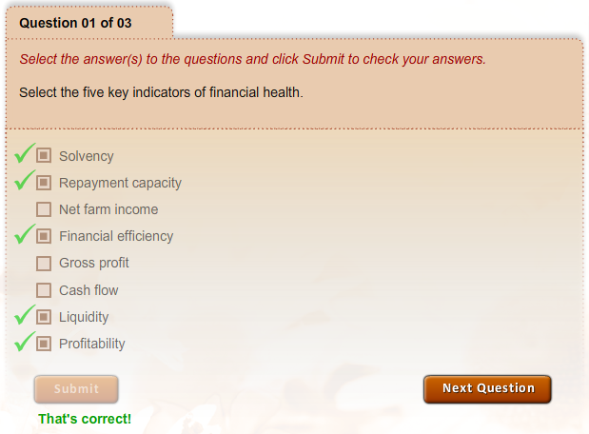
What is Financial Analysis?
What Have You Learned?

Slide 25
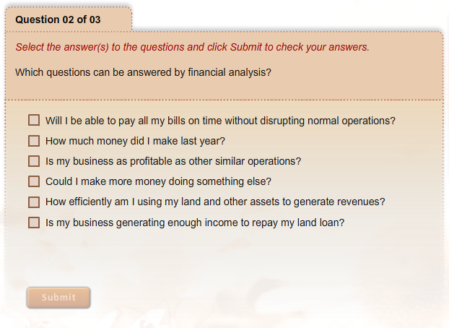
What is Financial Analysis?
What Have You Learned?
How to calculate a variety of financial ratios
Ratios parameters that indicate strength or weakness
Actions for improving financial performance in the five key areas

Slide 26
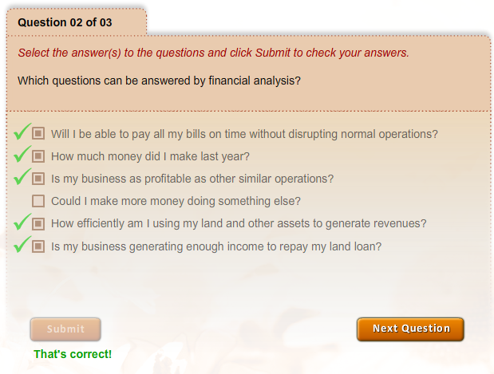
What is Financial Analysis?
What Have You Learned?

Slide 27
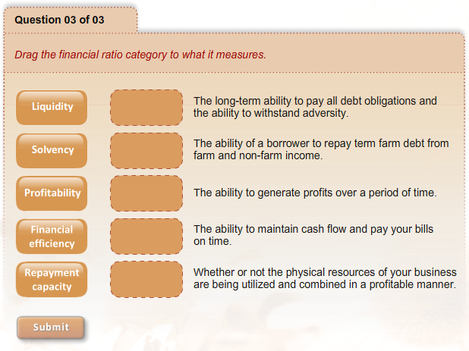
What is Financial Analysis?
What Have You Learned?
Drag the financial ratio category to what it measures.
How to assess financial health using financial ratios
How to calculate a variety of financial ratios
Ratios parameters that indicate strength or weakness
Actions for improving financial performance in the five key areas

Slide 28
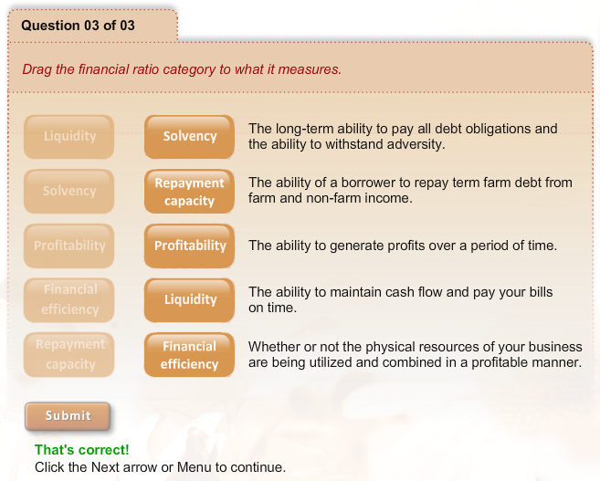
What is Financial Analysis?
What Have You Learned?
Drag the financial ratio category to what it measures.
How to assess financial health using financial ratios
How to calculate a variety of financial ratios
Ratios parameters that indicate strength or weakness
Actions for improving financial performance in the five key areas

Slide 29
What is Financial Analysis?
Key Points to Remember
Analyzing financial performance allows you to assess the financial health of your business in the same way a doctor assesses your physical health.
There are five key indicators of financial health: liquidity, solvency, profitability, financial efficiency, and repayment capacity.
The five key indicators are measured using financial ratios.
Notes:
Audio:
You have completed this lesson. Review the key points on screen and then click the Next button to select one of the five key areas of financial performance to explore more deeply.

