Slide 1
Understanding Financial Performance
Getting on Track Authors: Rodney L. Sharp, John P. Hewlett, Jeffrey E. Tranel
Notes:
Audio:
Welcome to Getting on Track: Understanding Financial Performance. In this course you will learn how to analyze the health of your business using financial ratios.
Click the next arrow to start at the beginning of the course or click the Menu link to select a lesson from the Main Menu. We recommend that you view the lessons in order the first time through the course.

Slide 2
Measures of Liquidity
Lesson 3

Slide 3
Measures of Liquidity
Liquidity Measures
The Farm Financial Standards Council recommends three ratios for measuring liquidity:
Current Ratio
Working Capital
Working Capital/Gross Revenues
Notes:
Audio:
Liquidity refers to your ability to maintain cash flow and pay your bills on time.
The Farm Financial Standards Council recommends three ratios for measuring liquidity: the Current Ratio, Working Capital, and the Working Capital to Gross Revenues ratio.
In this lesson, you will learn how to calculate and evaluate the Current and Working Capital ratios.

Slide 4
Measures of Liquidity
Liquidity Measures
The Farm Financial Standards Council recommends three ratios for measuring liquidity:
Current Ratio
Working Capital
Working Capital/Gross Revenues
Working Capital is a measure of the amount of funds available to purchase inputs and inventory items after the sale of current farm assets and payment of all current farm liabilities.

Slide 5
Measures of Liquidity
Liquidity Measures
The Farm Financial Standards Council recommends three ratios for measuring liquidity:
Current Ratio
Working Capital
Working Capital/Gross Revenues
Gross Revenues are the total received, not the profit, and does not show expenses deducted from income.

Slide 6
Measures of Liquidity
The Current Ratio
Notes:
Audio:
The Current Ratio is calculated by dividing current farm assets by the current farm liabilities.
Both of these values can be found on the balance sheet.
The results of this calculation will help you determine if there is sufficient cash flow in your business to meet all short-term financial obligations; in other words, to pay bills on time without disrupting the normal operations of the business.

Slide 7
Measures of Liquidity
Working Capital
Notes:
Audio:
The Working Capital ratio is similar to the Current Ratio and uses the same values. However, it is calculated by subtracting current farm liabilities from current farm assets.
Both of these values can be found on the balance sheet.
The Working Capital ratio provides another way to determine if there is sufficient cash flow to meet all short-term financial obligations.

Slide 8
Measures of Liquidity
Calculate the Ratios
Download Jack and Joanie’s financial statements. Then, calculate the current ratio. Click Submit to check your answers.
Notes:
Audio:
Now, try calculating the ratios. Click on the link to download Jack and Joanie’s financial statements. Then, calculate Jack and Joanie’s current ratio for example year 10 using book value sheet information. Click the calculator icon to access a calculator tool.
Click Submit to check your answer.

Slide 9
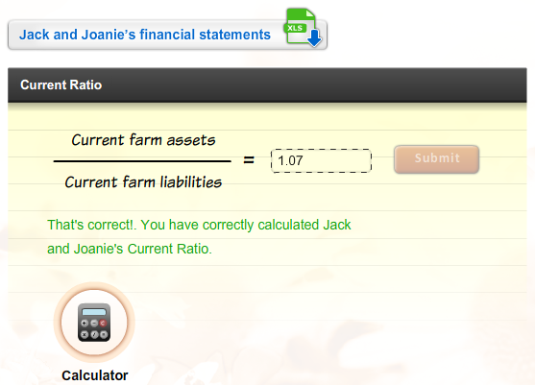
Measures of Liquidity
Calculate the Ratios
Download Jack and Joanie’s financial statements. Then, calculate the current ratio. Click Submit to check your answers.

Slide 10
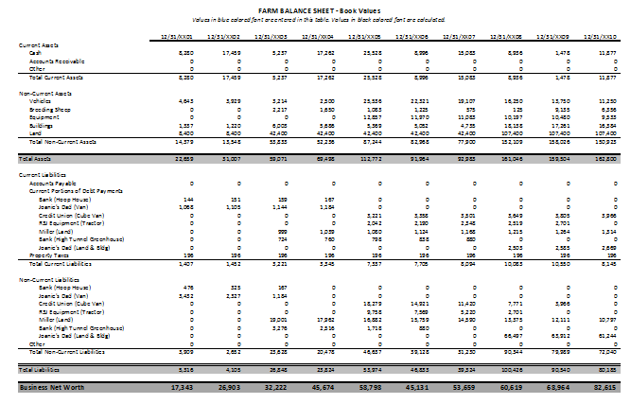
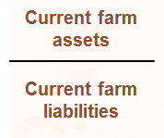
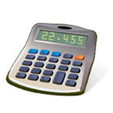
Measures of Liquidity
Calculate the Ratios
Download Jack and Joanie’s financial statements. Then, calculate the current ratio. Click Submit to check your answers.
Calculating the Current Ratio X
Step 1:
Locate the current farm assets value on Jack and Joanie’s balance sheet.
Step 2:
Locate the current farm liabilities value on Jack and Joanie’s balance sheet.
Step 3:
Divide the first value by the second value.
Current Ratio
=
1.75
=
10,543÷ 9, 845 = 1.07
That’s incorrect. Try again or click on the Hint icon for a little help.
Calculator
Calculator
SUBMIT
SUBMIT

Slide 11
Measures of Liquidity
Calculate the Ratios, Cont.
Download Jack and Joanie’s working capitol. Click Submit to check your answers.
Notes:
Audio:
Now, try calculating Jack and Joanie’s working capital. Click the calculator icon to access a calculator tool.
Click Submit to check your answer.

Slide 12
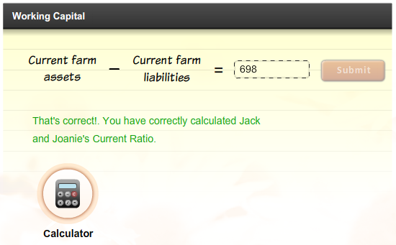
Measures of Liquidity
Calculate the Ratios, Cont.
Download Jack and Joanie’s working capitol. Click Submit to check your answers.

Slide 13
Measures of Liquidity
Calculate the Ratios, Cont.
Calculate Jack and Joanie’s working capital. Click Submit to check your answers.
Calculating Working Capital X
Calculate the Ratios
Download Jack and Joanie’s financial statements. Then, calculate the current ratio. Click Submit to check your answers.
Step 1:
Locate the current farm assets value on Jack and Joanie’s balance sheet.
Step 2:
Locate the current farm liabilities value on Jack and Joanie’s balance sheet.
Step 3:
Subtract the second value from the first value.
Current Ratio
=
1.75
That’s incorrect. Try again or click on the Hint icon for a little help.
Calculator
10,543 - 9,845 = 698
SUBMIT

Slide 14
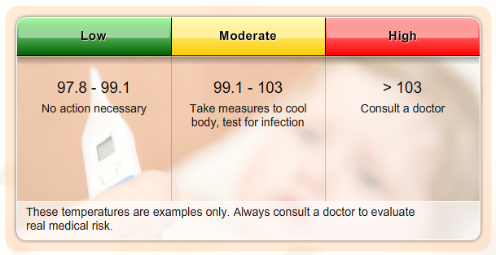
Measures of Liquidity
Evaluating the Results
Financial ratios are most valuable when you have a value to compare them to. This might be your ratio calculations from previous years or industry benchmarks.
Benchmarks: body temperature
Financial benchmarks work much the same way. Variations will occur between size of operations, owned versus leased, types of operation, location of operation, and other factors.
Notes:
Audio:
Financial ratios are most valuable when you have something to compare them to. This might be ratio calculations from previous years or industry benchmarks.
Benchmarks are guidelines or general rules of thumb related to a specific industry. For instance, a normal body temperature is between 97.8 and 99.1 degrees F.
However, body temperature can vary with age, geographical location, sleep/wake cycles and other variables. Thus, there is no single temperature that can be considered normal. The benchmark range simply allows a doctor to interpret the measurement and to decide if further action is required.
Financial benchmarks work much the same way.

Slide 15
Measures of Liquidity
Evaluating the Results
Financial ratios are only valuable when you have a value to compare them to. This might be your ratio calculations from previous years or industry benchmarks.
Benchmarks: body temperature
Financial benchmarks work much the same way. Variations will occur between size of operations, owned versus leased, types of operation, location of operation, and other factors.
Benchmarks:
Guidelines or rules of thumb for the parameters that represent a “normal” state or situation. In financial benchmarks the “normal” state is dependent on a number of variables including the industry, market, and size/type of operation in which a particular results is generated.

Slide 16
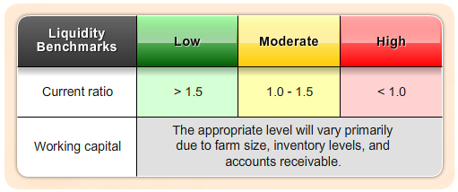
Measures of Liquidity
Liquidity Ratio Benchmarks
Possible Actions For Improvement: Increase sales, decrease short term debt and other financial obligations, restructure debt to better reflect to current assets, evaluate a marketing plan to better time cash inflows and outflows.
Notes:
Audio:
Some benchmarks for liquidity ratio values are shown on screen.
The benchmarks are meant to be only a guideline for comparison purposes.
The correlated benchmarks are presented in terms of green, yellow, and red lights. A green light represents a financial strength with low risk. A yellow light corresponds to moderate risk, and a red light means weakness and high risk. A green light doesn’t guarantee success, nor does a red light imply failure. A weakness in one area may be overcome by strengths in other areas.
Each farm operator should establish specific benchmarks for their specific farm situation.

Slide 17
Measures of Liquidity
What Have You Learned?
Notes:
Audio:
Check what you have learned about measures of liquidity by answering the questions on screen. Click Submit to check your answers.

Slide 18
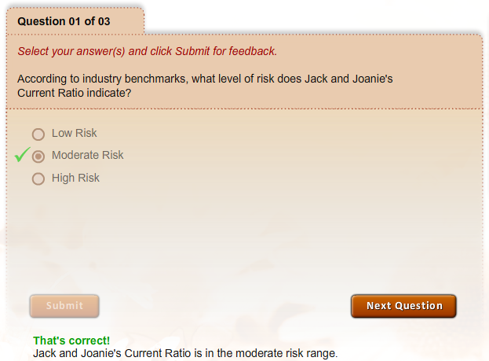
Measures of Liquidity
What Have You Learned?

Slide 19
Measures of Liquidity
What Have You Learned?

Slide 20
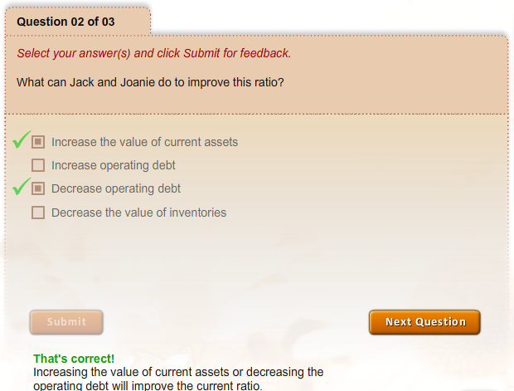
Measures of Liquidity
What Have You Learned?

Slide 21
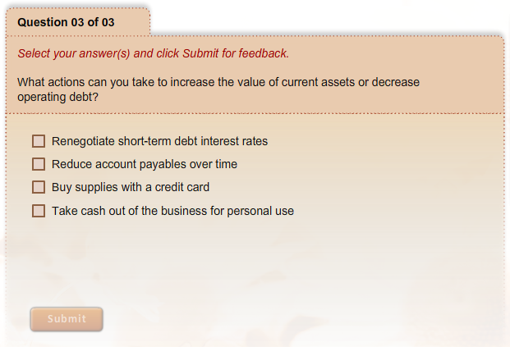
Measures of Liquidity
What Have You Learned?

Slide 22
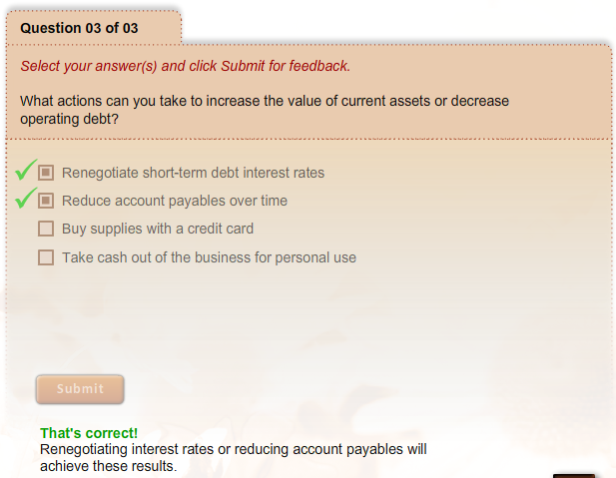
Measures of Liquidity
What Have You Learned?

