Slide 1
Understanding Financial Performance
Getting on Track Authors: Rodney L. Sharp, John P. Hewlett, Jeffrey E. Tranel
Notes:
Audio:
Welcome to Getting on Track: Understanding Financial Performance. In this course you will learn how to analyze the health of your business using financial ratios.
Click the next arrow to start at the beginning of the course or click the Menu link to select a lesson from the Main Menu. We recommend that you view the lessons in order the first time through the course.

Slide 2
Measures of Solvency
Lesson 4

Slide 3
Measures of Solvency
Solvency Measures
The Farm Financial Standards Council recommends three ratios for measuring solvency:
Debt/Asset ratio
Equity/Asset ratio
Debt/Equity ratio
Notes:
Audio:
Solvency measures provide an indication of your long-term ability to repay all financial obligations and your ability to withstand adversity.
The Farm Financial Standards Council recommends three ratios for measuring solvency; the Debt to Asset ratio, the Equity to Asset ratio, and the Debt to Equity ratio.
In this lesson, you will learn how to calculate and evaluate the Debt to Asset and Equity to Asset ratios.

Slide 4
Measures of Solvency
Solvency Measures
The Farm Financial Standards Council recommends three ratios for measuring solvency:
Debt/Asset ratio
Equity/Asset ratio
Debt/Equity ratio
Debt is an obligation to repay something, usually money borrowed from an individual or business.

Slide 5
Measures of Solvency
Solvency Measures
The Farm Financial Standards Council recommends three ratios for measuring solvency:
Debt/Asset ratio
Equity/Asset ratio
Debt/Equity ratio
Asset:
Assets are tangible or intangible items of value that you own or that are owed to you.

Slide 6
Measures of Solvency
Solvency Measures
The Farm Financial Standards Council recommends three ratios for measuring solvency:
Debt/Asset ratio
Equity/Asset ratio
Debt/Equity ratio
Equity:
The difference between the total value of your assets and the total value of your debts or liabilities. Equity is also referred to as “Net Worth”.

Slide 7
Measures of Solvency
The Debt/Asset Ratio
Notes:
Audio:
The Debt to Asset ratio is calculated by dividing total farm liabilities by the total farm assets.
Both of these values can be found on the balance sheet.
The results of this calculation will help you measure your ability to pay long term obligation and to withstand financial adversity.

Slide 8
Measures of Solvency
The Equity/Asset Ratio
Notes:
Audio:
The Equity/Asset ratio is calculated by dividing total farm equity by total farm assets.
Both of these values can be found on the balance sheet.
The Equity/Asset ratio measures the owner’s level of investment in the business.

Slide 9
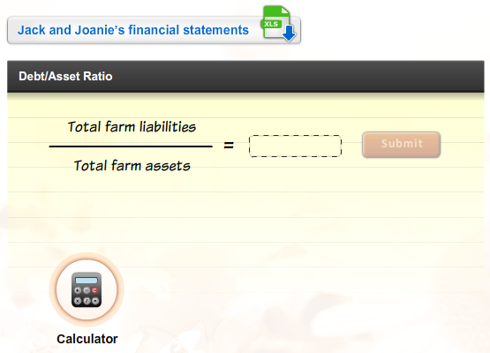
Measures of Solvency
Calculate the Ratios
Download Jack and Joanie’s financial statements. Then, calculate the debt/asset ratio. Click Submit to check your answers.
Notes:
Audio:
Now, try calculating the ratios. Click on the link to download Jack and Joanie’s financial statements. Then, calculate Jack and Joanie’s debt/asset ratio, for example for year 10 using book value balance sheet information. Click the calculator icon to access a calculator tool.
Click Submit to check your answer

Slide 10
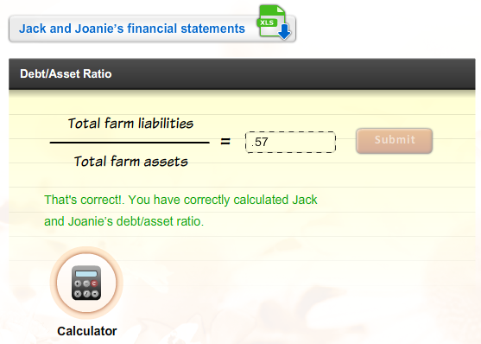
Measures of Solvency
Calculate the Ratios
Download Jack and Joanie’s financial statements. Then, calculate the debt/asset ratio. Click Submit to check your answers.

Slide 11
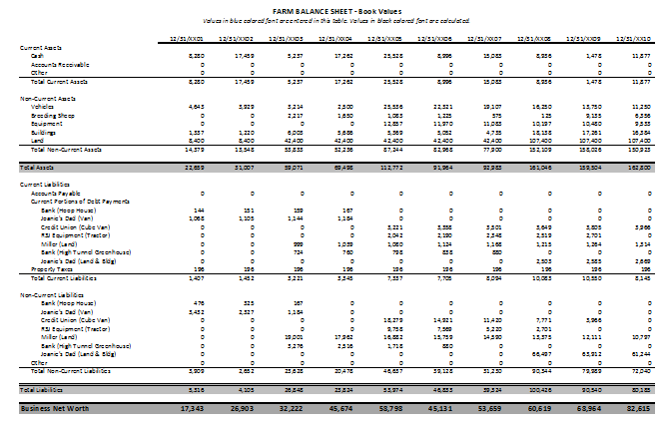
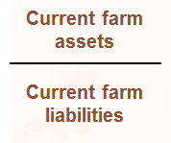
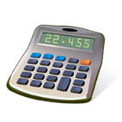
Measures of Solvency
Calculate the Ratios
Download Jack and Joanie’s financial statements. Then, calculate the debt/asset ratio. Click Submit to check your answers.
Calculating the Debt/Asset Ratio X
Calculate the Ratios
Download Jack and Joanie’s financial statements. Then, calculate the current ratio. Click Submit to check your answers.
Step 1:
Locate the total farm liabilities value on Jack and Joanie’s balance sheet.
Step 2:
Locate the total farm assets value on Jack and Joanie’s balance sheet.
Step 3:
Divide the first value by the second value.
Current Ratio
=
That’s incorrect. Try again or click on the Hint icon for a little help.
75, 927 ÷ 136,466 = 0.57
Calculator
SUBMIT

Slide 12
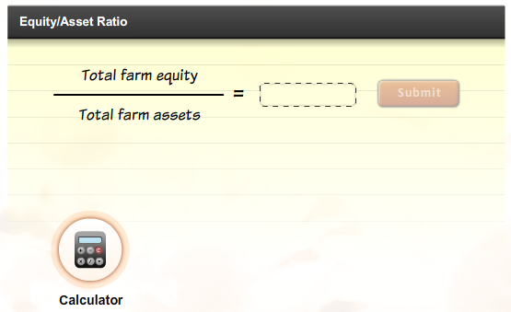
Measures of Solvency
Calculate the Ratios
Download Jack and Joanie’s financial statements. Then, calculate the debt/asset ratio. Click Submit to check your answers.
Notes:
Audio:
Now, try calculating Jack and Joanie’s equity to asset ratio for example year 10 using book value balance sheet information. Click the calculator icon to access a calculator tool.
Click Submit to check your answer.

Slide 13
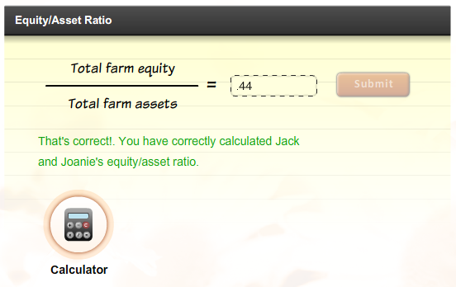
Measures of Solvency
Calculate the Ratios
Download Jack and Joanie’s financial statements. Then, calculate the debt/asset ratio. Click Submit to check your answers.

Slide 14
Measures of Solvency
Calculate the Ratios
Download Jack and Joanie’s financial statements. Then, calculate the debt/asset ratio. Click Submit to check your answers.
Calculating the Equity/Asset Ratio X
Calculate the Ratios
Download Jack and Joanie’s financial statements. Then, calculate the current ratio. Click Submit to check your answers.
Step 1:
Locate the total farm equity value on Jack and Joanie’s balance sheet.
Step 2:
Locate the total farm assets value on Jack and Joanie’s balance sheet.
Step 3:
Divide the first value by the second value.
Current Ratio
=
1.75
60,615 ÷ 136,466 = 0.44
That’s incorrect. Try again or click on the Hint icon for a little help.
SUBMIT

Slide 15
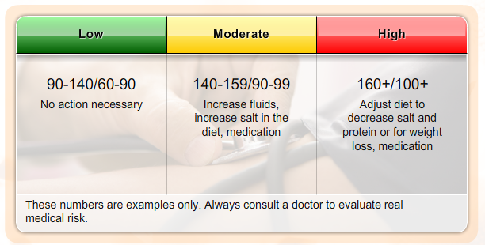
Measures of Solvency
Evaluating the Results
Financial ratios are most valuable when you have a value to compare them to. This might be your ratio calculations from previous years or industry benchmarks.
Benchmarks: blood pressure
Financial benchmarks work much the same way. Variations will occur between size of operations, owned versus leased, types of operation, location of operation, and other factors.
Notes:
Audio:
Financial ratios are most valuable when you have something to compare them to. This might be ratio calculations from previous years or industry benchmarks.
Benchmarks are guidelines or general rules of thumb related to a specific industry. For instance, a normal blood pressure is between 90/60 and 140/90. However, blood pressure can vary with age, activity level, time of day and other variables. Thus, there is no single blood pressure that can be considered normal. The benchmark range simply allows a doctor to interpret the measurement and to decide if further action is required.
Financial benchmarks work much the same way.

Slide 16
Measures of Solvency
Evaluating the Results
Financial ratios are most valuable when you have a value to compare them to. This might be your ratio calculations from previous years or industry benchmarks.
Benchmarks: blood pressure
Financial benchmarks work much the same way. Variations will occur between size of operations, owned versus leased, types of operation, location of operation, and other factors.
Benchmarks:
Guidelines or rules of thumb for the parameters that represent a “normal” state or situation. In financial benchmarks the “normal” state is dependent on a number of variables including the industry, market, and size/type of operation in which a particular result is generated.

Slide 17
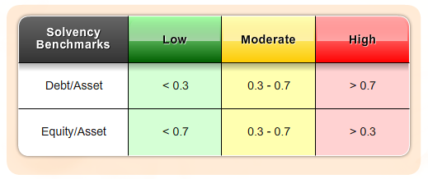
Measures of Solvency
Solvency Ratio Benchmarks
Possible Actions For Improvement: Increase operating profits, make additional principal payments on term debt, avoid unnecessary capital expenditures, reduce family living withdrawals.
Notes:
Audio:
Some benchmarks for solvency ratio values are shown on screen.
The benchmarks are meant to be only a guideline for comparison purposes.
The correlated benchmarks are presented in terms of green, yellow, and red lights. A green light represents a financial strength with low risk. A yellow light corresponds to moderate risk, and a red light means weakness and high risk. A green light doesn’t guarantee success, nor does a red light imply failure. A weakness in one area may be overcome by strengths in other areas.
Each farm operator should establish specific benchmarks for their specific farm situation.

Slide 18
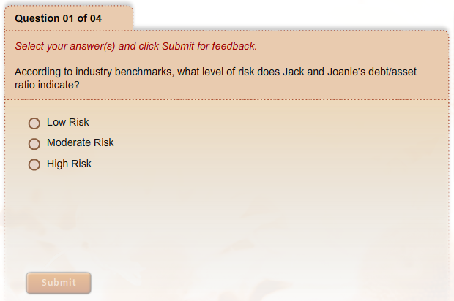
Measures of Solvency
What Have You Learned?
Notes:
Audio:
Check what you have learned about measures of solvency by answering the questions on screen. Click Submit to check your answers.

Slide 19
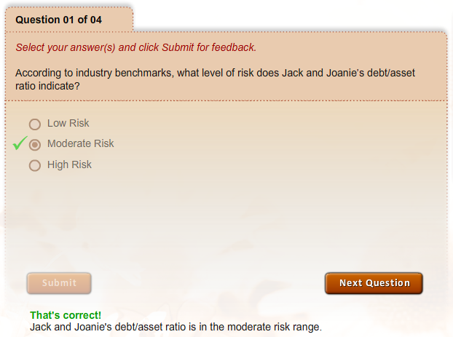
Measures of Solvency
What Have You Learned?

Slide 20
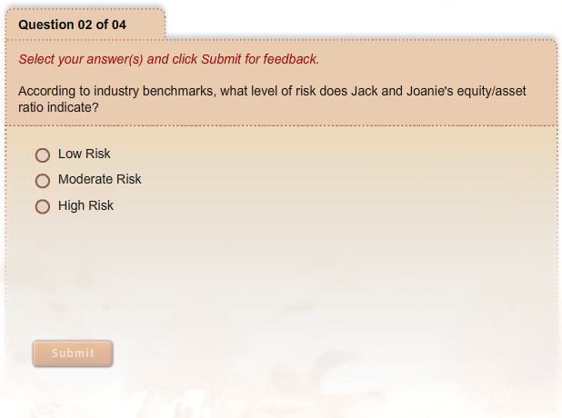
Measures of Solvency
What Have You Learned?

Slide 21
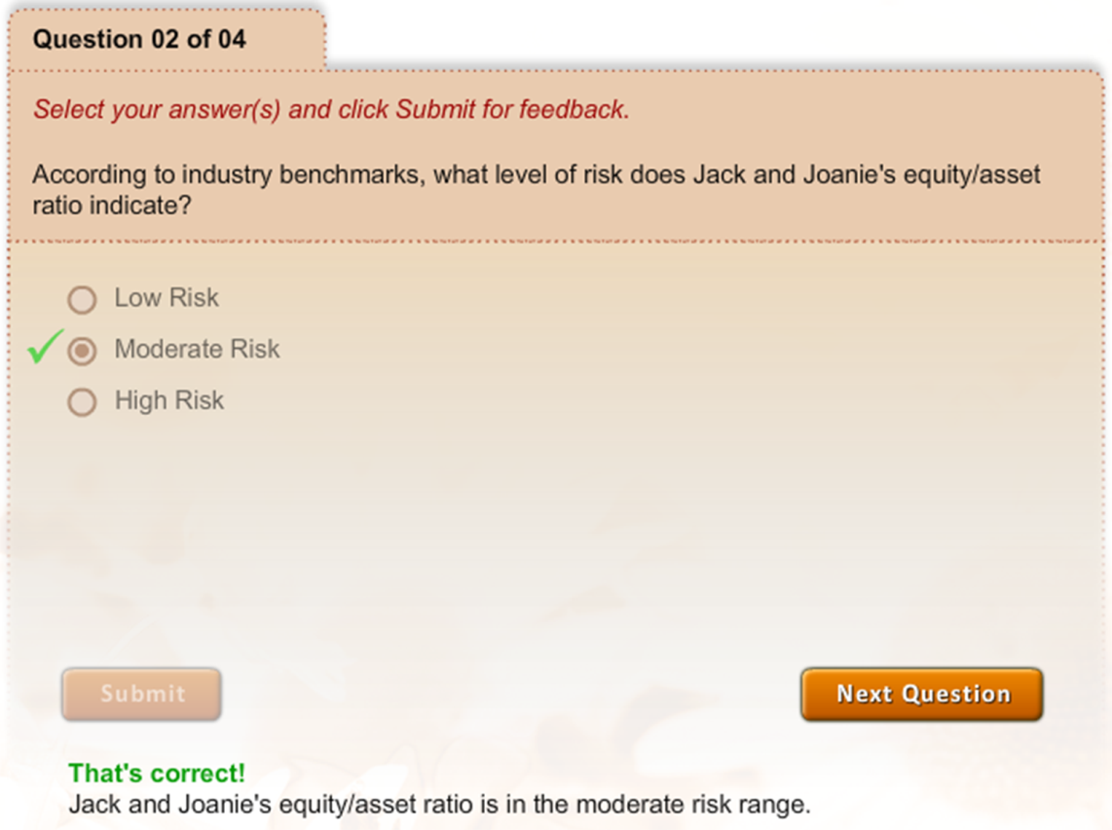
Measures of Solvency
What Have You Learned?

Slide 22
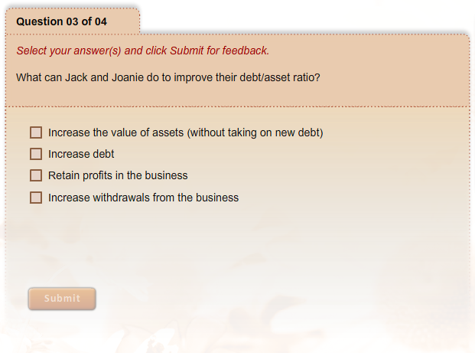
Measures of Solvency
What Have You Learned?

Slide 23
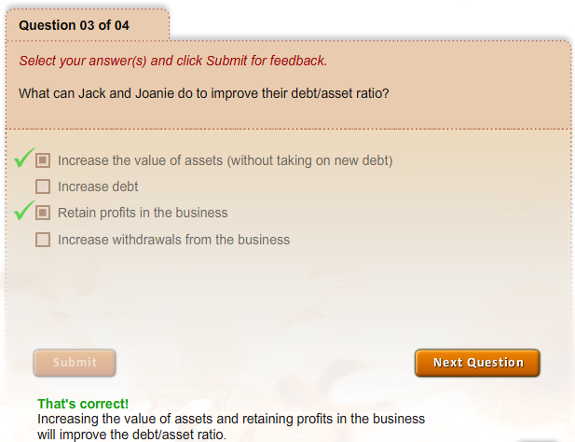
Measures of Solvency
What Have You Learned?

Slide 24
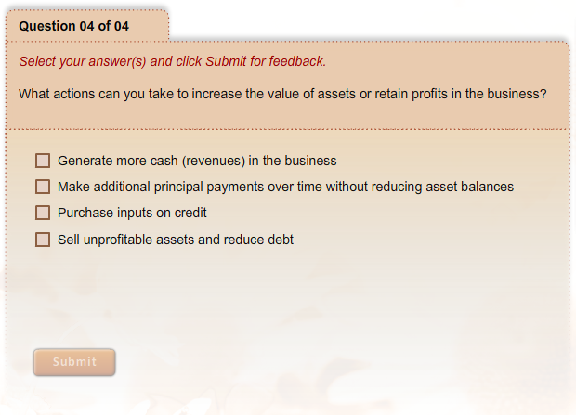
Measures of Solvency
What Have You Learned?

Slide 25
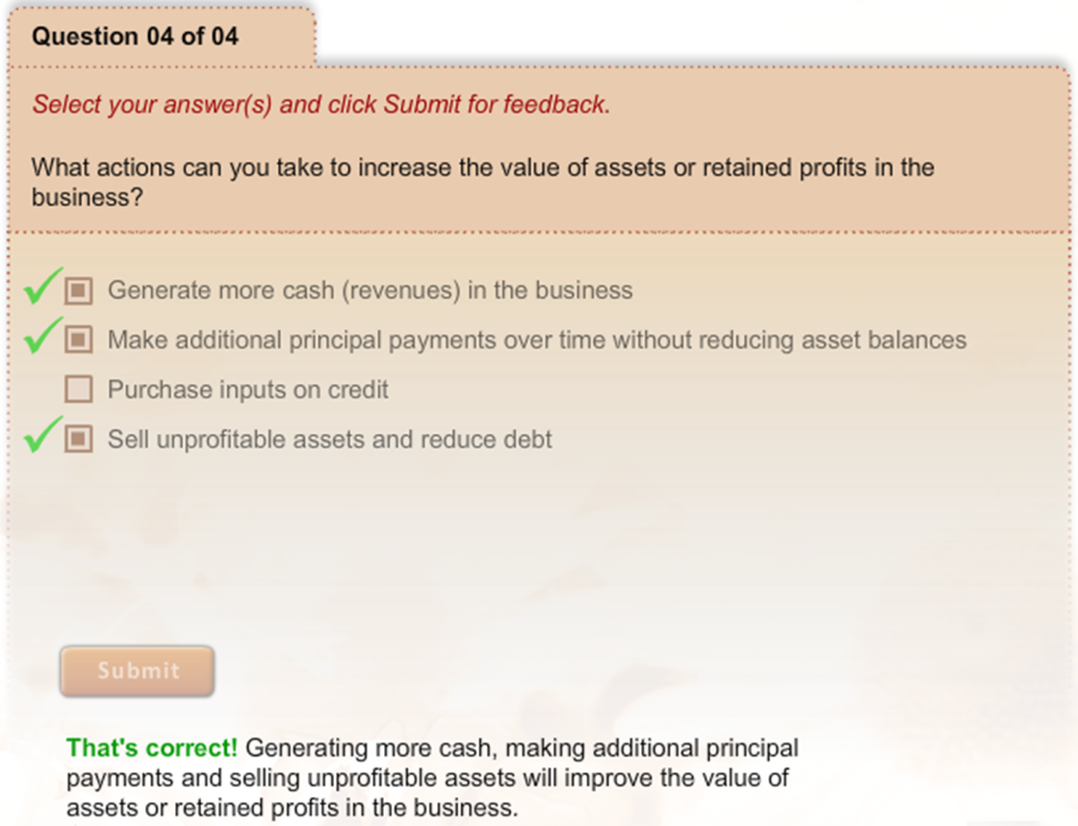
Measures of Solvency
What Have You Learned?

