Slide 1
Understanding
Financial Performance
Getting on Track
Authors: Rodney L. Sharp, John P. Hewlett, Jeffrey E. Tranel
Notes:
Audio:
Welcome to Getting on Track: Understanding Financial Performance. In this course you will learn how to analyze the health of your business using financial ratios.
Click the next arrow to start at the beginning of the course or click the Menu link to select a lesson from the Main Menu. We recommend that you view the lessons in order the first time through the course.

Slide 2
Measures of Profitability
Lesson 5

Slide 3

Measures of Profitability
Profitability Measures
The Farm Financial Standards Council recommends five ratios for measuring profitability:
Rate of Return on Assets.
Rate of Return on Equity.
Operating Profit Margin.
Net Farm Income.
Earnings Before Interest,
Tax, Depreciation, and
Amortization (EBITDA).
Notes:
Audio:
Profitability refers to your ability to generate profits (income minus expenses) over a period of time.
The Farm Financial Standards Council recommends five ratios for measuring profitability; Rate of Return on Assets, Rate of Return on Equity, Operating Profit Margin, Net Farm Income, Earnings Before Interest, Tax, Depreciation, and Amortization (EBITDA).
In this lesson, you will learn how to calculate and evaluate the Rate of Return on Assets and Rate of Return on Equity ratios.

Slide 4
Measures of Profitability
Profitability Measures
The Farm Financial Standards Council recommends five ratios for measuring profitability:
Rate of Return on Assets.
Rate of Return on Equity.
Operating Profit Margin.
Net Farm Income.
Earnings Before Interest,
Tax, Depreciation, and
Amortization (EBITDA).
Profit Margin is the amount by which revenue from sales exceeds costs in a business.

Slide 5
Measures of Profitability
Profitability Measures
The Farm Financial Standards Council recommends five ratios for measuring profitability:
Rate of Return on Assets.
Rate of Return on Equity.
Operating Profit Margin.
Net Farm Income.
Earnings Before Interest,
Tax, Depreciation, and
Amortization (EBITDA).
Depreciation is the process of spreading out the cost of an asset over its useful life due to use, age, and obsolescence. The purpose of this process is to provide information on the asset's current value to calculate business expenses. There are many different methods for calculating depreciation.

Slide 6
Measures of Profitability
Profitability Measures
The Farm Financial Standards Council recommends five ratios for measuring profitability:
Rate of Return on Assets.
Rate of Return on Equity.
Operating Profit Margin.
Net Farm Income.
Earnings Before Interest,
Tax, Depreciation, and
Amortization (EBITDA).
Amortization is the reduction of the value of an asset by prorating its cost over a period of years.

Slide 7
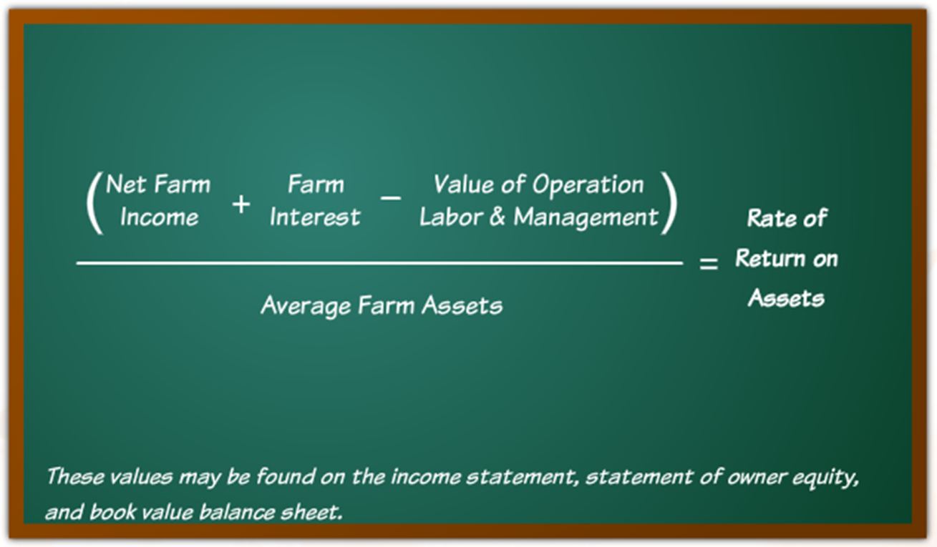
Measures of Profitability
Rate of Return on Assets
Notes:
Audio:
Rate of return on assets is calculated with the formula shown on screen.
These values can be found on the income statement and balance sheet.
The results of this calculation will help you compare your earnings to the value of the assets used in the production process

Slide 8
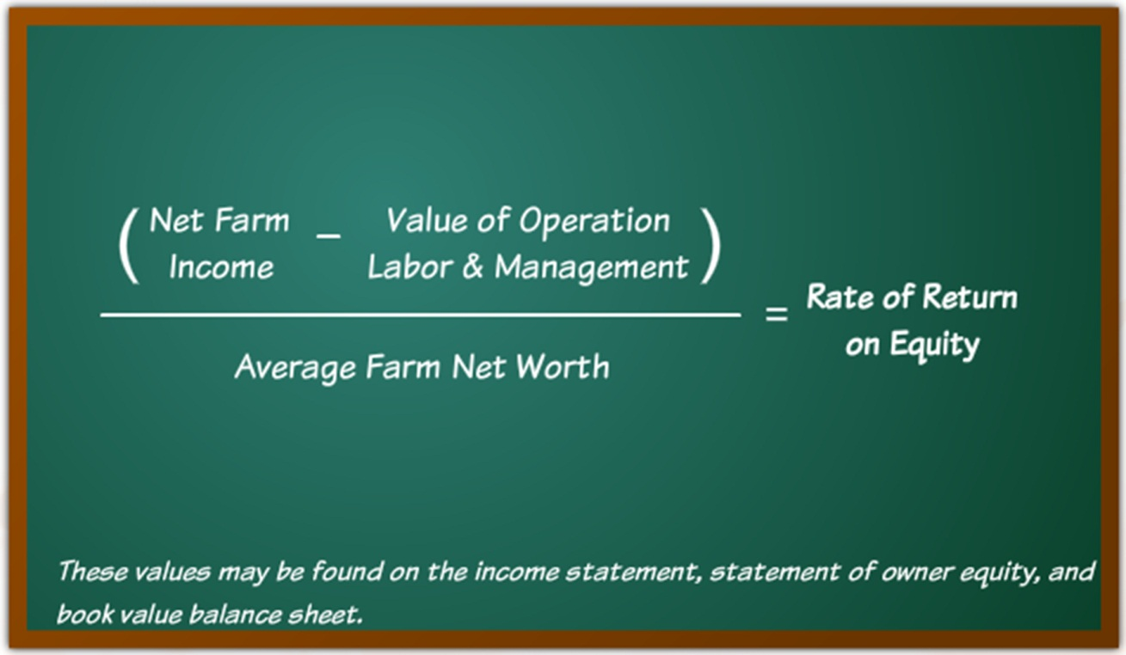
Measures of Profitability
Rate of Return on Equity
Notes:
Audio:
Rate of return on equity is calculated with the formula shown on screen.
These values can be found on the income statement and balance sheet.
Rate of return on equity compares the earnings of the business to the business owner’s investment in the production process.

Slide 9
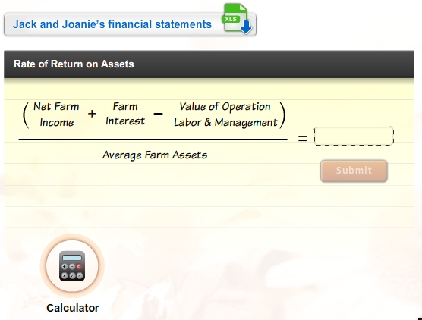
Measures of Profitability
Calculate the Ratios
Download Jack and Joanie’s financial statements.
Then, calculate the rate of return on assets.
Click Submit to check your answers.
Notes:
Audio:
Now, try calculating the ratios. Click on the link to download Jack and Joanie’s financial statements. Then, calculate Jack and Joanie’s rate of return on assets. Click the calculator icon to access a calculator tool.
Click Submit to check your answer.

Slide 10
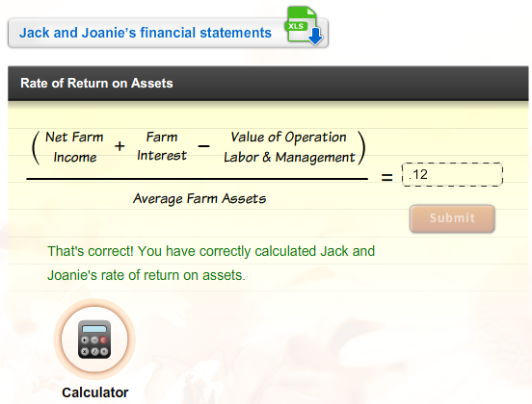
Measures of Profitability
Calculate the Ratios
Download Jack and Joanie’s financial statements.
Then, calculate the rate of return on assets.
Click Submit to check your answers.

Slide 11
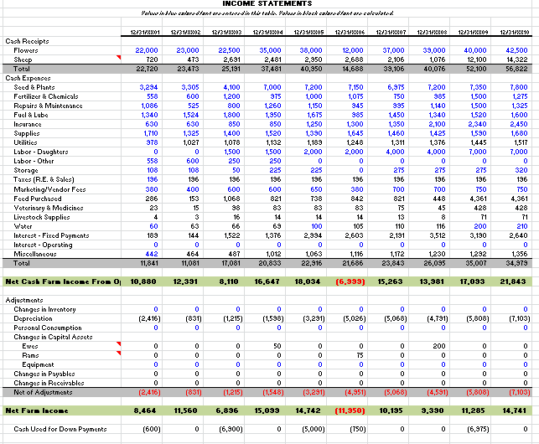
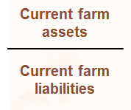

Measures of Profitability
Calculate the Ratios, Cont.
Calculate Jack and Joanie’s equity/asset ratio. Click Submit to check your answers.
Calculating the Rate of Return on Assets X
Step 1:
Locate the net farm income on Jack and Joanie’s income statement.
Step 2:
Locate the interest expense on Jack and Joanie’s income statement.
Step 3:
Add these two values together.
Current Ratio
=
1.75
That’s incorrect. Try again or click on the Hint icon for a little help.
14,741 + 2,640 = 17,381
SUBMIT
Next Slide

Slide 12
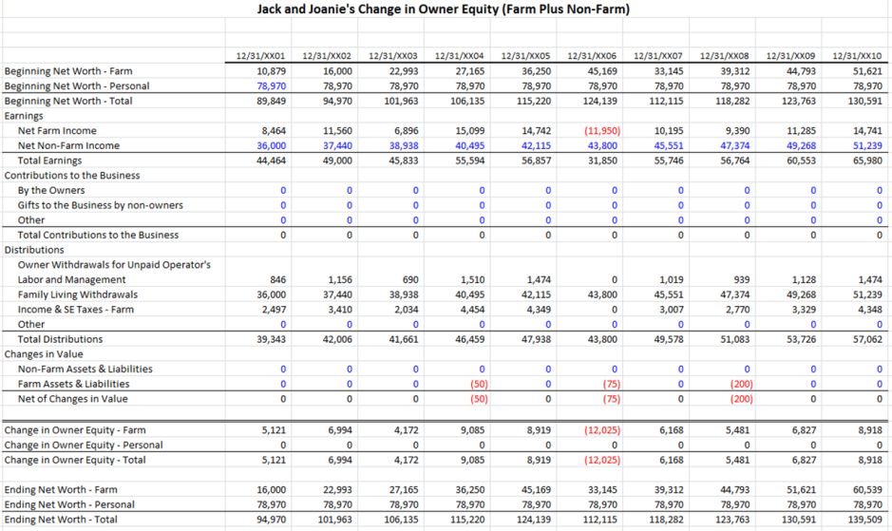
Measures of Profitability
Calculate the Ratios, Cont.
Calculate Jack and Joanie’s equity/asset ratio. Click Submit to check your answers.
Calculating the Rate of Return on Assets X
Step 4:
Locate the value of operation labor & management on Jack and Joanie’s statement of owner equity. This represents the amount of money they paid themselves for working on and running the farm.
Step 5:
Subtract this value from your previous total.
Current Ratio
=
1.75
17,381 - 1,474 = 15,907
That’s incorrect. Try again or click on the Hint icon for a little help.
SUBMIT
Next Slide

Slide 13
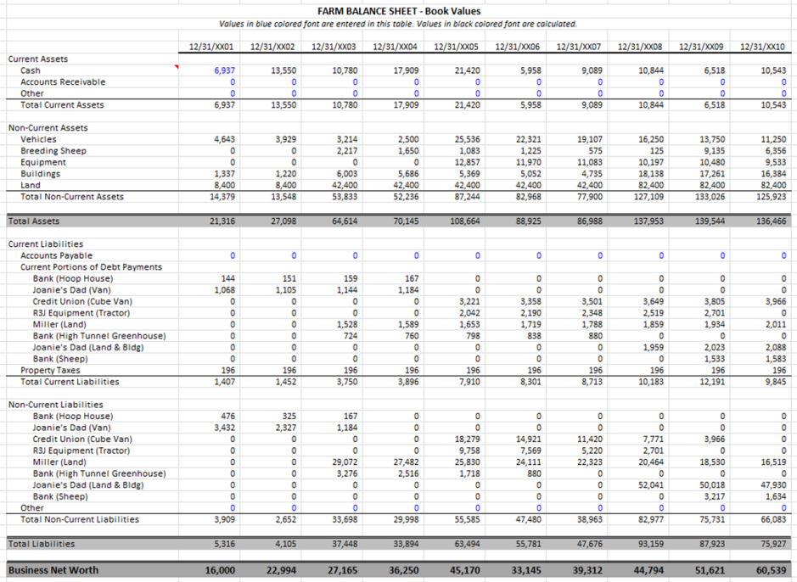
Measures of Profitability
Calculate the Ratios, Cont.
Calculate Jack and Joanie’s equity/asset ratio. Click Submit to check your answers.
Calculating the Rate of Return on Assets X
Step 6:
Determine the average farm assets on Jack and Joanie’s balance sheet by adding the total assets from the past two reporting periods and dividing it by 2.
Step 7:
Divide the result of Step 5 by this value.
Current Ratio
139,544 + 136,466
2
= 138,005
=
1.75
15,907
138,005
= 0.12
That’s incorrect. Try again or click on the Hint icon for a little help.
SUBMIT

Slide 14
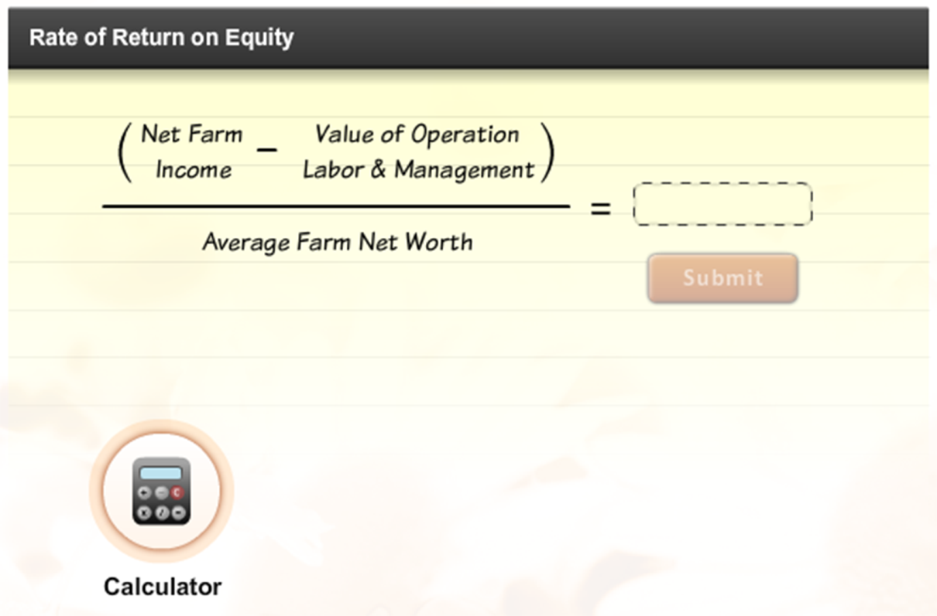
Measures of Profitability
Calculate the Ratios
Download Jack and Joanie’s financial statements.
Then, calculate the rate of return on assets.
Click Submit to check your answers.
Notes:
Audio:
Now, try calculating Jack and Joanie’s rate of return on equity. Click the calculator icon to access a calculator tool.
Click Submit to check your answer.

Slide 15
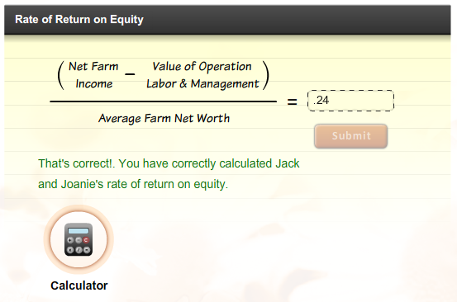
Measures of Profitability
Calculate the Ratios
Download Jack and Joanie’s financial statements.
Then, calculate the rate of return on assets.
Click Submit to check your answers.

Slide 16
Measures of Profitability
Calculate the Ratios, Cont.
Calculate Jack and Joanie’s equity/asset ratio. Click Submit to check your answers.
Calculating the Rate of Return on Equity X
Step 1:
Locate the net farm income on Jack and Joanie’s income statement.
Current Ratio
=
1.75
That’s incorrect. Try again or click on the Hint icon for a little help.
SUBMIT
Next Slide

Slide 17
Measures of Profitability
Calculate the Ratios, Cont.
Calculate Jack and Joanie’s equity/asset ratio. Click Submit to check your answers.
Calculating the Rate of Return on Equity X
Step 2:
Locate the value of operation labor & management on Jack and Joanie’s statement of owner equity.
Step 3:
Subtract this value from the net farm income.
Current Ratio
=
1.75
14,741 - 1,474 = 13,267
That’s incorrect. Try again or click on the Hint icon for a little help.
SUBMIT
Next Slide

Slide 18
Measures of Profitability
Calculate the Ratios, Cont.
Calculate Jack and Joanie’s equity/asset ratio. Click Submit to check your answers.
Calculating the Rate of Return on Equity X
Step 4:
Determine the average farm net worth on Jack and Joanie’s balance sheet by adding the total net worth from the past two reporting periods and dividing it by 2.
Step 5:
Divide the result of Step 3 by this value.
Current Ratio
51,621 + 60,539
2
= 56,080
=
1.75
13,267
56,080
= 0. 24
That’s incorrect. Try again or click on the Hint icon for a little help.
SUBMIT

Slide 19
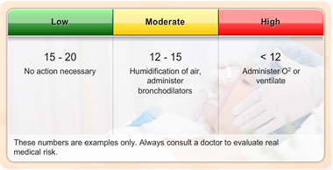
Measures of Profitability
Evaluating the Results
Financial ratios are most valuable when you have a value to compare them to. This might be your ratio calculations from previous years or industry benchmarks.
Benchmarks: blood pressure
Financial benchmarks work much the same way. Variations will occur between size of operations, owned versus leased, types of operation, location of operation, and other factors.
Notes:
Audio:
Financial ratios are most valuable when you have something to compare them to. This might be ratio calculations from previous years or industry benchmarks.
Benchmarks are guidelines or general rules of thumb related to a specific industry. For instance, normal respiration is between 15 and 20 breaths per minute. However, body respiration can vary with age, emotional state, activity level, and other variables.
Thus, there is no single respiration rate that can be considered normal. The benchmark range simply allows a doctor to interpret the measurement and to decide if further action is required.
Financial benchmarks work much the same way.

Slide 20
Measures of Profitability
Evaluating the Results
Financial ratios are most valuable when you have a value to compare them to. This might be your ratio calculations from previous years or industry benchmarks.
Benchmarks: blood pressure
Financial benchmarks work much the same way. Variations will occur between size of operations, owned versus leased, types of operation, location of operation, and other factors.
Benchmarks:
Guidelines or rules of thumb for the parameters that represent a “normal” state or situation. In financial benchmarks the “normal” state is dependent on a number of variables including the industry, market, and size/type of operation in which a particular result is generated.
Notes:
Audio:
Financial ratios are most valuable when you have something to compare them to. This might be ratio calculations from previous years or industry benchmarks.
Benchmarks are guidelines or general rules of thumb related to a specific industry. For instance, normal respiration is between 15 and 20 breaths per minute. However, body respiration can vary with age, emotional state, activity level, and other variables.
Thus, there is no single respiration rate that can be considered normal. The benchmark range simply allows a doctor to interpret the measurement and to decide if further action is required.
Financial benchmarks work much the same way.

Slide 21
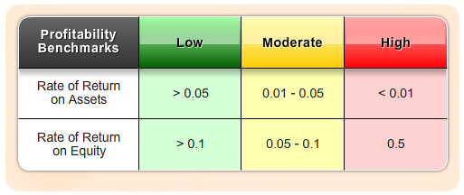
Measures of Profitability
Profitability Ratio Benchmarks
    Possible Actions For Improvement: Increase the value of production, reduce production costs where prudent, control or reduce family living withdrawals, improve marketing practices, properly structure debt to revenue generation.
Notes:
Audio:
Some benchmarks for profitability ratio values are shown on screen.
The benchmarks are meant to be only a guideline for comparison purposes.
The correlated benchmarks are presented in terms of green, yellow, and red lights. A green light represents a financial strength with low risk. A yellow light corresponds to moderate risk, and a red light means weakness and high risk. A green light doesn’t guarantee success, nor does a red light imply failure. A weakness in one area may be overcome by strengths in other areas.
Each farm operator should establish specific benchmarks for their specific farm situation.

Slide 22
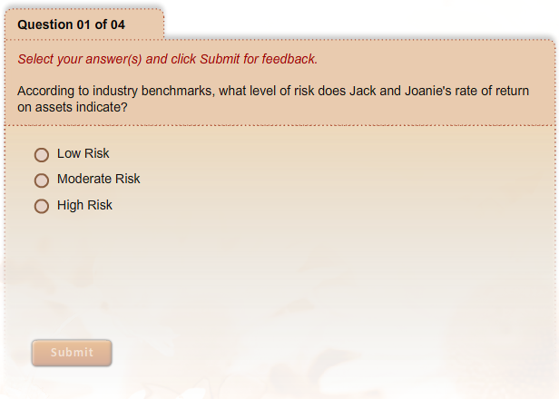
Measures of Profitability
What Have You Learned?
Notes:
Audio:
Check what you have learned about measures of profitability by answering the questions on screen. Click Submit to check your answers.

Slide 23
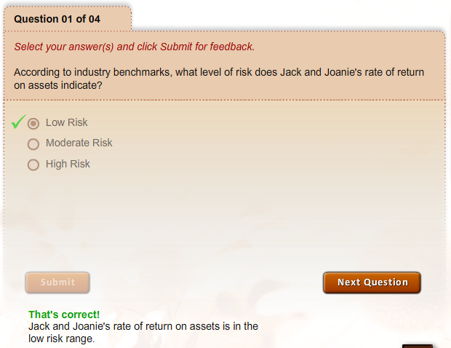
Measures of Profitability
What Have You Learned?

Slide 24
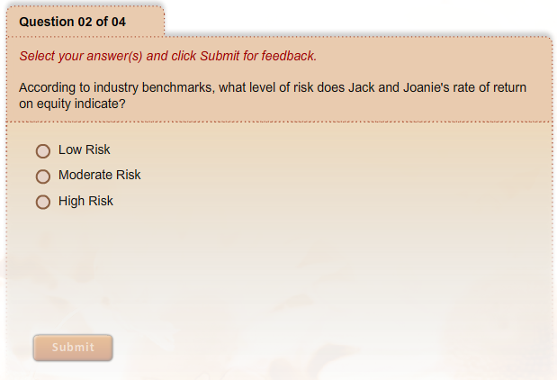
Measures of Profitability
What Have You Learned?

Slide 25
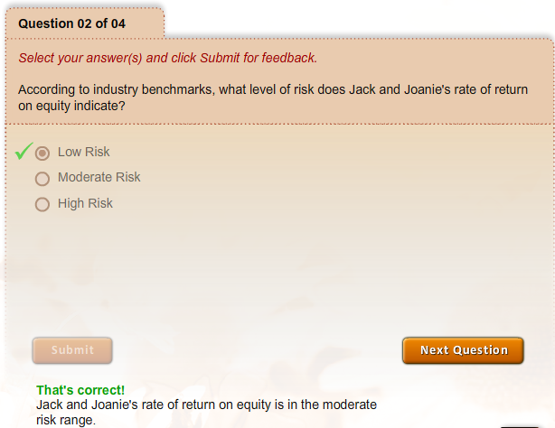
Measures of Profitability
What Have You Learned?

Slide 26
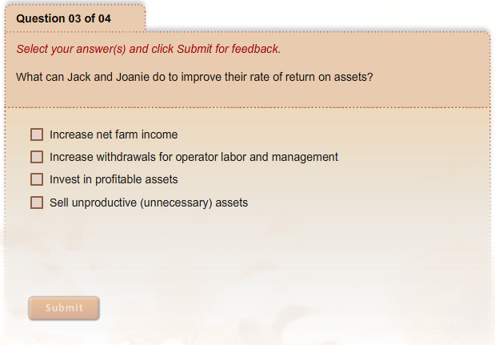
Measures of Profitability
What Have You Learned?

Slide 27
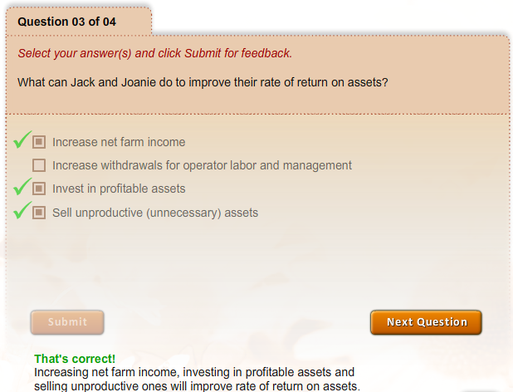
Measures of Profitability
What Have You Learned?

Slide 28
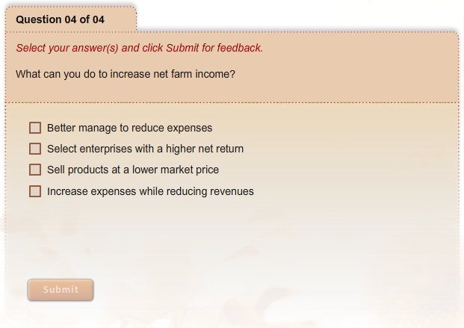
Measures of Profitability
What Have You Learned?

Slide 29
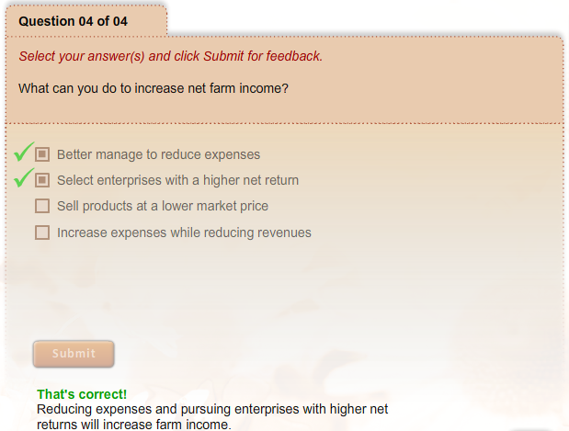
Measures of Profitability
What Have You Learned?

