Slide 1
Understanding
Financial Performance
Getting on Track
Authors: Rodney L. Sharp, John P. Hewlett, Jeffrey E. Tranel
Notes:
Audio:
Welcome to Getting on Track: Understanding Financial Performance. In this course you will learn how to analyze the health of your business using financial ratios.
Click the next arrow to start at the beginning of the course or click the Menu link to select a lesson from the Main Menu. We recommend that you view the lessons in order the first time through the course.

Slide 2
Measures of Financial Efficiency
Lesson 6

Slide 3

Measures of Financial Efficiency
Financial Efficiency Measures
The Farm Financial Standards Council recommends five ratios for measuring financial efficiency:
Asset Turnover
Operating Expense
Interest Expense
Depreciation Expense
Net Farm Income from Operations
Notes:
Audio:
Financial efficiency refers to whether or not the physical resources of your business are being utilized and combined in a profitable manner.
The Farm Financial Standards Council recommends five ratios for measuring financial efficiency; Asset Turnover, Operating Expense, Interest Expense, Depreciation Expense, and Net Farm Income from Operations.
In this lesson, you will learn how to calculate and evaluate the Asset Turnover, Operating Expense, and Interest Expense ratios.

Slide 4
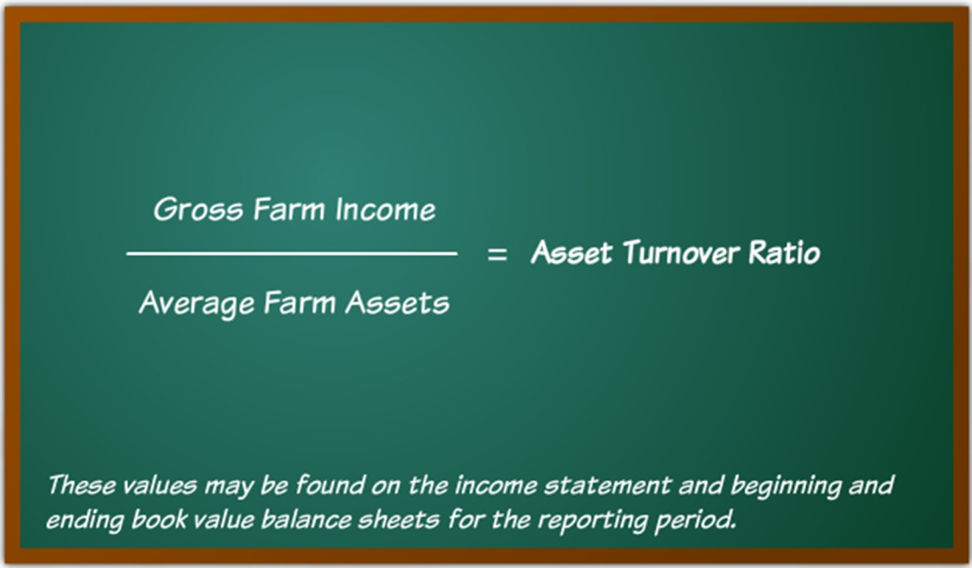
Measures of Financial Efficiency
The Asset Turnover Ratio
Notes:
Audio:
The Asset Turnover ratio is calculated by dividing Gross Farm Income by Average Farm Assets.
These values can be found on the income statement and beginning and ending balance sheets for the reporting period.
The results of this calculation will help you assess how efficiently the business is using its assets to generate revenue.

Slide 5
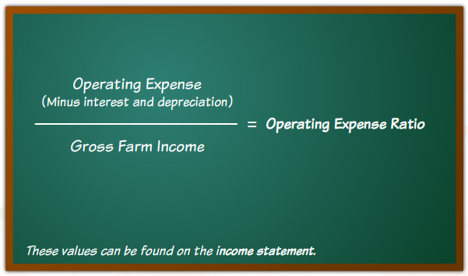
Measures of Financial Efficiency
The Operating Expense Ratio
Notes:
Audio:
The Operating Expense ratio is calculated by dividing Operating Expense (excluding interest and depreciation) by Gross Farm Income.
These values can be found on the income statement.
The Operating Expense ratio measures how efficiently the business is using operating inputs to generate income.

Slide 6
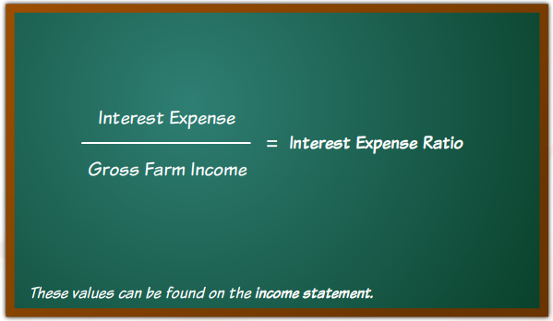
Measures of Financial Efficiency
The Interest Expense Ratio
Notes:
Audio:
The Interest Expense ratio is calculated by dividing Interest Expense by Gross Farm Income.
These values can be found on the income statement.
The Interest Expense ratio measures the amount of gross farm income used to pay for interest on borrowed capital.

Slide 7
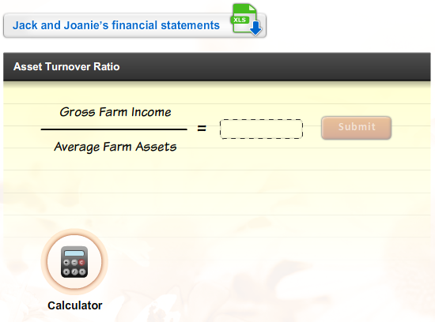
Measures of Financial Efficiency
Calculate the Ratios
Download Jack and Joanie’s financial statements. Then, calculate the asset turnover ratio. Click Submit to check
your answers.
Notes:
Audio:
Now, try calculating the ratios. Click on the link to download Jack and Joanie’s financial statements. Then, calculate Jack and Joanie’s asset turnover ratio. Click the calculator icon to access a calculator tool.
Click Submit to check your answer.

Slide 8
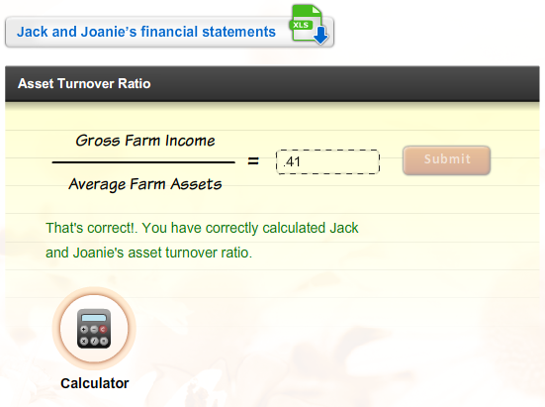
Measures of Financial Efficiency
Calculate the Ratios
Download Jack and Joanie’s financial statements. Then, calculate the asset turnover ratio. Click Submit to check
your answers.

Slide 9
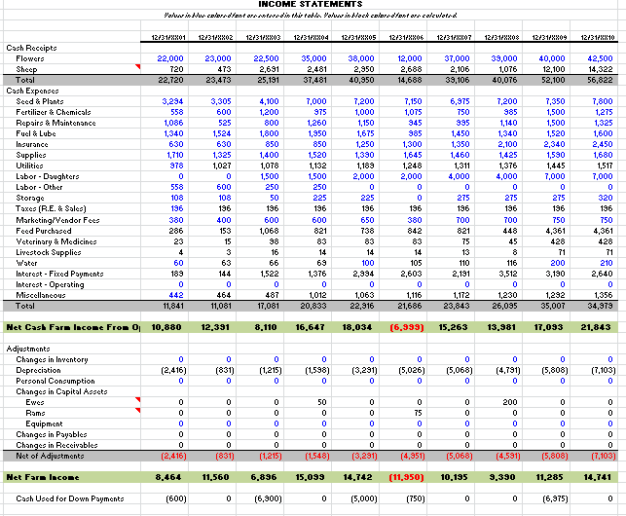
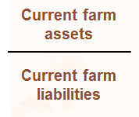

Measures of Financial Efficiency
Calculate the Ratios, Cont.
Calculate Jack and Joanie’s equity/asset ratio. Click Submit to check your answers.
Calculating the Asset Turnover Ratio X
Step 1:
Locate the gross farm income value on Jack and Joanie’s income statement.
Current Ratio
=
1.75
That’s incorrect. Try again or click on the Hint icon for a little help.
SUBMIT
Next Slide

Slide 10
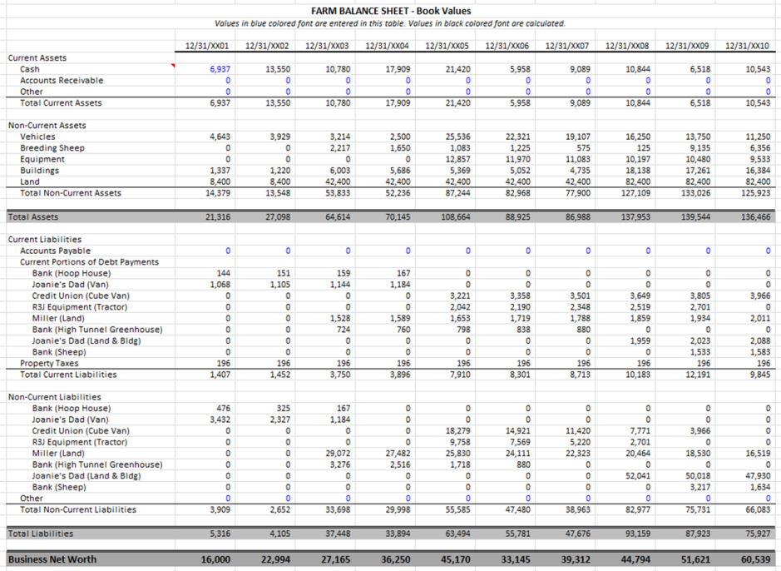
Measures of Financial Efficiency
Calculate the Ratios, Cont.
Calculate Jack and Joanie’s equity/asset ratio. Click Submit to check your answers.
Calculating the Asset Turnover Ratio X
Step 2:
Determine the average farm assets on Jack and Joanie’s balance sheet by adding the total assets from the past two reporting periods and dividing it by 2.
Step 3:
Divide the gross farm income by this value.
Current Ratio
139,544 + 136,466
2
= 138,005
=
1.75
56,822
138,005
= 0.41
That’s incorrect. Try again or click on the Hint icon for a little help.
SUBMIT

Slide 11
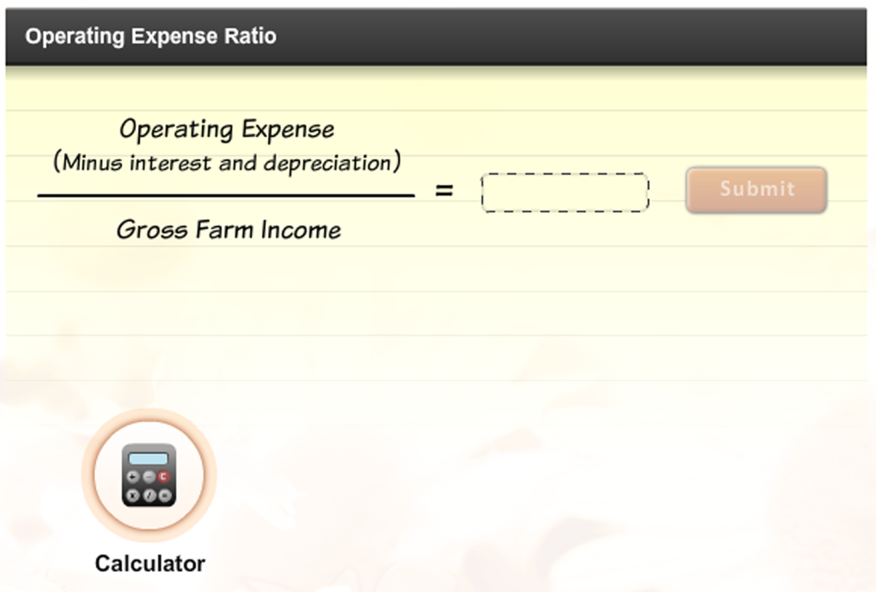
Measures of Financial Efficiency
Calculate the Ratios
Download Jack and Joanie’s financial statements. Then, calculate the asset turnover ratio. Click Submit to check
your answers.
Notes:
Audio:
Now, try calculating Jack and Joanie’s operating expense ratio, using information from the income statement and book value balance sheet for example year 10.
Click the calculator icon to access a calculator tool.
Click Submit to check your answer.

Slide 12
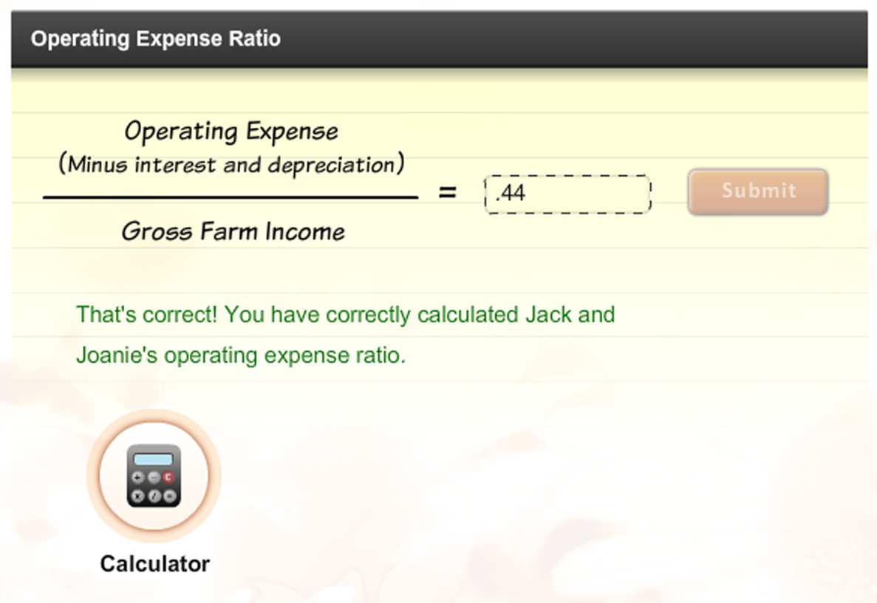
Measures of Financial Efficiency
Calculate the Ratios
Download Jack and Joanie’s financial statements. Then, calculate the asset turnover ratio. Click Submit to check
your answers.

Slide 13
Measures of Financial Efficiency
Calculate the Ratios, Cont.
Calculate Jack and Joanie’s equity/asset ratio. Click Submit to check your answers.
Calculating the Operating Expense Ratio X
Step 1:
Locate the total operating expenses on Jack and Joanie’s income statement.
Step 2:
Locate the interest expense on Jack and Joanie’s income statement.
Current Ratio
=
1.75
That’s incorrect. Try again or click on the Hint icon for a little help.
SUBMIT
Next Slide

Slide 14
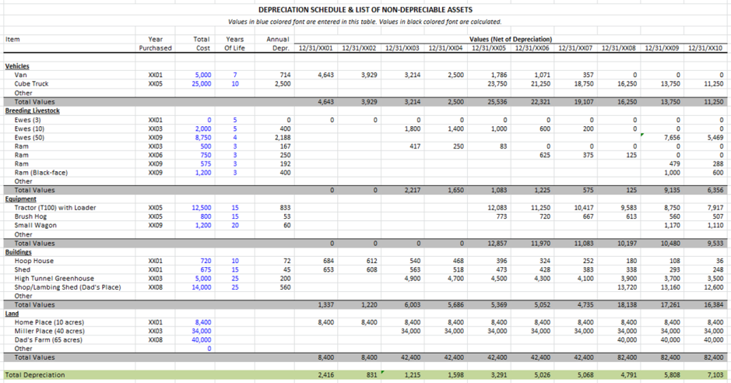
Measures of Financial Efficiency
Calculate the Ratios, Cont.
Calculate Jack and Joanie’s equity/asset ratio. Click Submit to check your answers.
Calculating the Operating Expense Ratio X
Step 3:
Locate the total depreciation expense on Jack and Joanie’s depreciation schedule.
Step 4:
Subtract the interest and depreciation expenses from the total operating expenses.
Current Ratio
=
1.75
39,979 – 2,640 – 7,103
= 25,236
That’s incorrect. Try again or click on the Hint icon for a little help.
SUBMIT
Next Slide

Slide 15
Measures of Financial Efficiency
Calculate the Ratios, Cont.
Calculate Jack and Joanie’s equity/asset ratio. Click Submit to check your answers.
Calculating the Operating Expense Ratio X
Step 5:
Locate the gross farm income value on Jack and Joanie’s income statement.
Step 6:
Divide the result of Step 4 by the gross farm income.
Current Ratio
=
1.75
25,236
56,822
= 0.44
That’s incorrect. Try again or click on the Hint icon for a little help.
SUBMIT

Slide 16
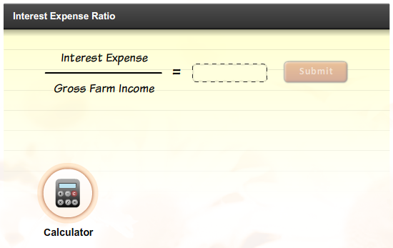
Measures of Financial Efficiency
Calculate the Ratios
Download Jack and Joanie’s financial statements. Then, calculate the asset turnover ratio. Click Submit to check
your answers.
Notes:
Audio:
Now, try calculating Jack and Joanie’s interest expense ratio, using information from the income statement and book value balance sheet for example year 10.
Click the calculator icon to access a calculator tool.
Click Submit to check your answer.

Slide 17
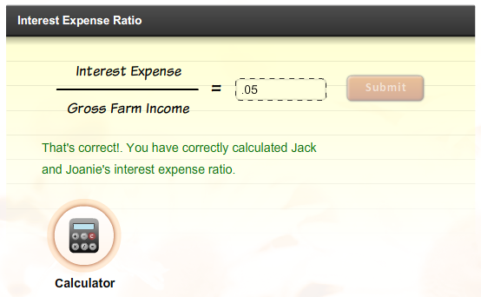
Measures of Financial Efficiency
Calculate the Ratios
Download Jack and Joanie’s financial statements. Then, calculate the asset turnover ratio. Click Submit to check
your answers.

Slide 18
Measures of Financial Efficiency
Calculate the Ratios, Cont.
Calculate Jack and Joanie’s equity/asset ratio. Click Submit to check your answers.
Calculating the Interest Expense Ratio X
Step 1:
Locate the interest expense value on Jack and Joanie’s income statement.
Step 2:
Locate the gross farm income value on Jack and Joanie’s income statement.
Step 3:
Divide the first value by the second value.
Current Ratio
=
1.75
That’s incorrect. Try again or click on the Hint icon for a little help.
2,640 ÷ 56,822 = 0.05
SUBMIT

Slide 19
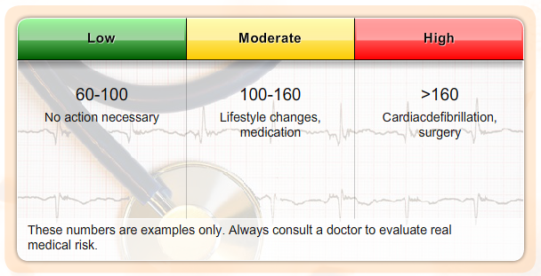
Measures of Financial Efficiency
Evaluating the Results
Financial ratios are most valuable when you have a value to compare them to. This might be your ratio calculations from previous years or industry benchmarks.
Benchmarks: resting heart rate
Financial benchmarks work much the same way. Variations will occur between size of operations, owned versus leased, types of operation, location of operation, and other factors.
Notes:
Audio:
Financial ratios are most valuable when you have something to compare them to. This might be ratio calculations from previous years or industry benchmarks.
Benchmarks are guidelines or general rules of thumb related to a specific industry. For instance, a normal heart rate is between 60 and 100 beats per minute.
However, heart rate can vary with age, athletic conditioning, exposure to stress and other variables. Thus, there is no single heart rate that can be considered normal. The benchmark range simply allows a doctor to interpret the measurement and to decide if further action is required.
Financial benchmarks work much the same way.

Slide 20
Measures of Financial Efficiency
Evaluating the Results
Financial ratios are most valuable when you have a value to compare them to. This might be your ratio calculations from previous years or industry benchmarks.
Benchmarks: resting heart rate
Financial benchmarks work much the same way. Variations will occur between size of operations, owned versus leased, types of operation, location of operation, and other factors.
Benchmarks:
Guidelines or rules of thumb for the parameters that represent a “normal” state or situation. In financial benchmarks the “normal” state is dependent on a number of variables including the industry, market, and size/type of operation in which a particular result is generated.

Slide 21
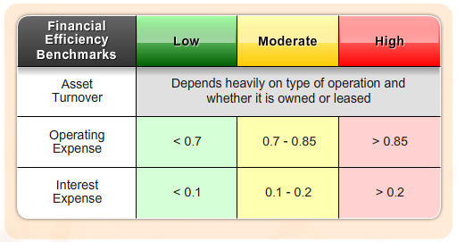
Measures of Financial Efficiency
Financial Efficiency Ratio Benchmarks
    Possible Actions For Improvement: Increase the value of production, reduce production costs where prudent, control or reduce family living withdrawals, improve marketing practices, properly structure debt to revenue generation.
Notes:
Audio:
Some benchmarks for profitability ratio values are shown on screen.
The benchmarks are meant to be only a guideline for comparison purposes.
The correlated benchmarks are presented in terms of green, yellow, and red lights. A green light represents a financial strength with low risk. A yellow light corresponds to moderate risk, and a red light means weakness and high risk. A green light doesn’t guarantee success, nor does a red light imply failure. A weakness in one area may be overcome by strengths in other areas.
Each farm operator should establish specific benchmarks for their specific farm situation.

Slide 22
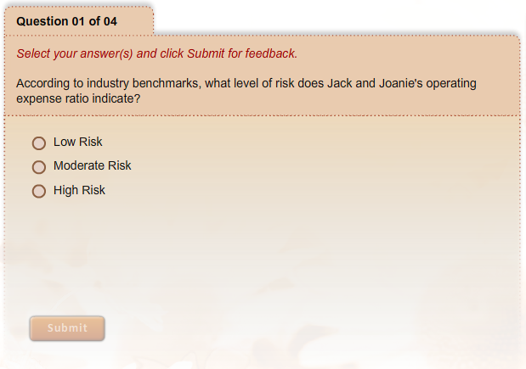
Measures of Financial Efficiency
What Have You Learned?
Notes:
Audio:
Check what you have learned about measures of financial efficiency by answering the questions on screen. Click Submit to check your answers.

Slide 23
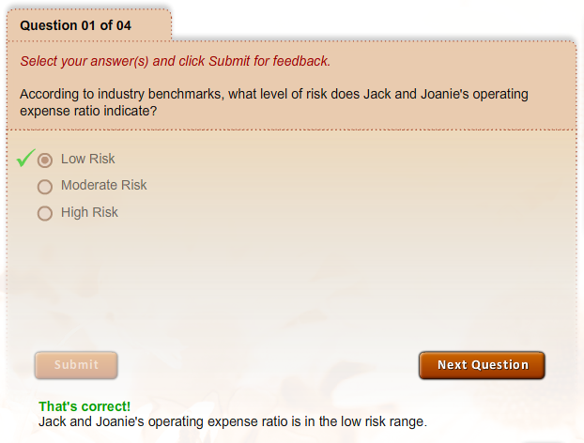
Measures of Financial Efficiency
What Have You Learned?

Slide 24
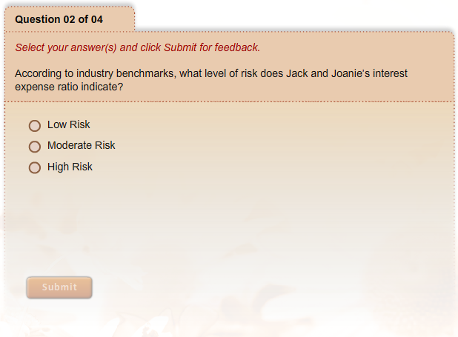
Measures of Financial Efficiency
What Have You Learned?

Slide 25
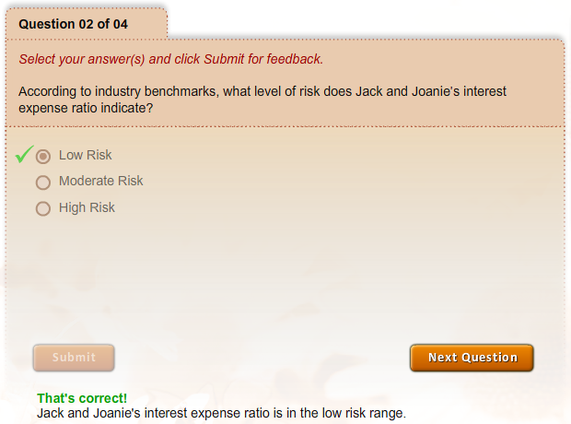
Measures of Financial Efficiency
What Have You Learned?

Slide 26
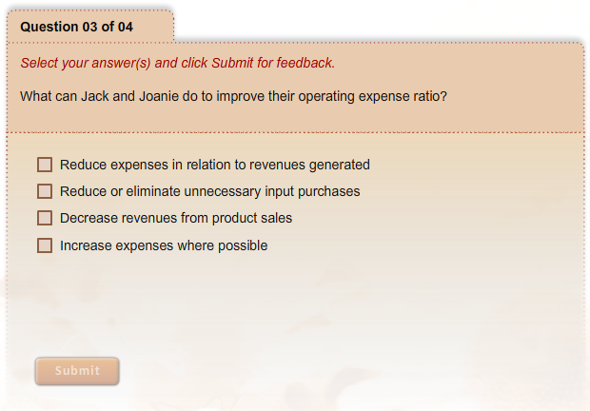
Measures of Financial Efficiency
What Have You Learned?

Slide 27
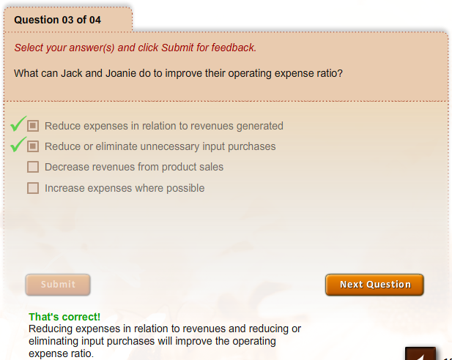
Measures of Financial Efficiency
What Have You Learned?

Slide 28
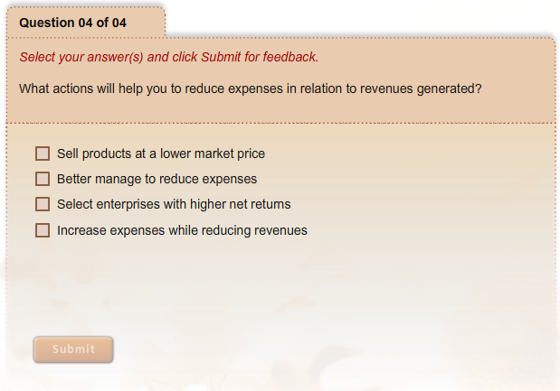
Measures of Financial Efficiency
What Have You Learned?

Slide 29
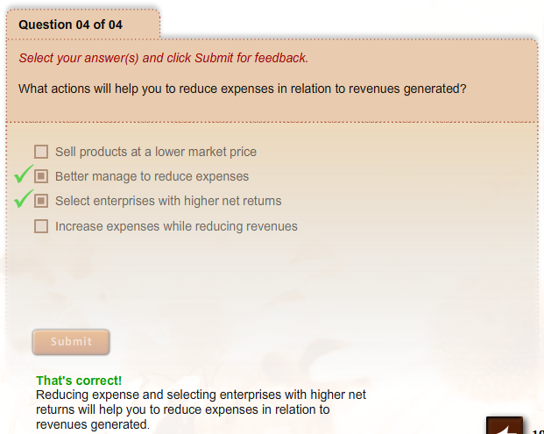
Measures of Financial Efficiency
What Have You Learned?

