Slide 1
Understanding
Financial Performance
Getting on Track
Authors: Rodney L. Sharp, John P. Hewlett, Jeffrey E. Tranel
Notes:
Audio:
Welcome to Getting on Track: Understanding Financial Performance. In this course you will learn how to analyze the health of your business using financial ratios.
Click the next arrow to start at the beginning of the course or click the Menu link to select a lesson from the Main Menu. We recommend that you view the lessons in order the first time through the course.

Slide 2
Measures of Repayment Capacity
Lesson 7

Slide 3

Measures of Repayment Capacity
Repayment Capacity Measures
The Farm Financial Standards Council recommends five ratios for measuring repayment capacity:
Capital Debt Repayment
Capacity
Term Debt and Capital
Lease Coverage Ratio
Capital Debt Repayment
Margin
Replacement Margin
Replacement Margin
Coverage Ratio
Notes:
Audio:
Repayment capacity refers to the ability of a borrower to repay term farm debt from farm and non-farm income.
The Farm Financial Standards Council recommends five ratios for measuring repayment capacity: Capital Debt Repayment Capacity, Term Debt and Capital Lease Coverage Ratio, Capital Debt Repayment Margin, Replacement Margin, and Replacement Margin Coverage Ratio.
In this lesson, you will learn how to calculate and evaluate the Capital Debt Repayment Capacity and Term Debt and Capital Lease Coverage ratio.

Slide 4
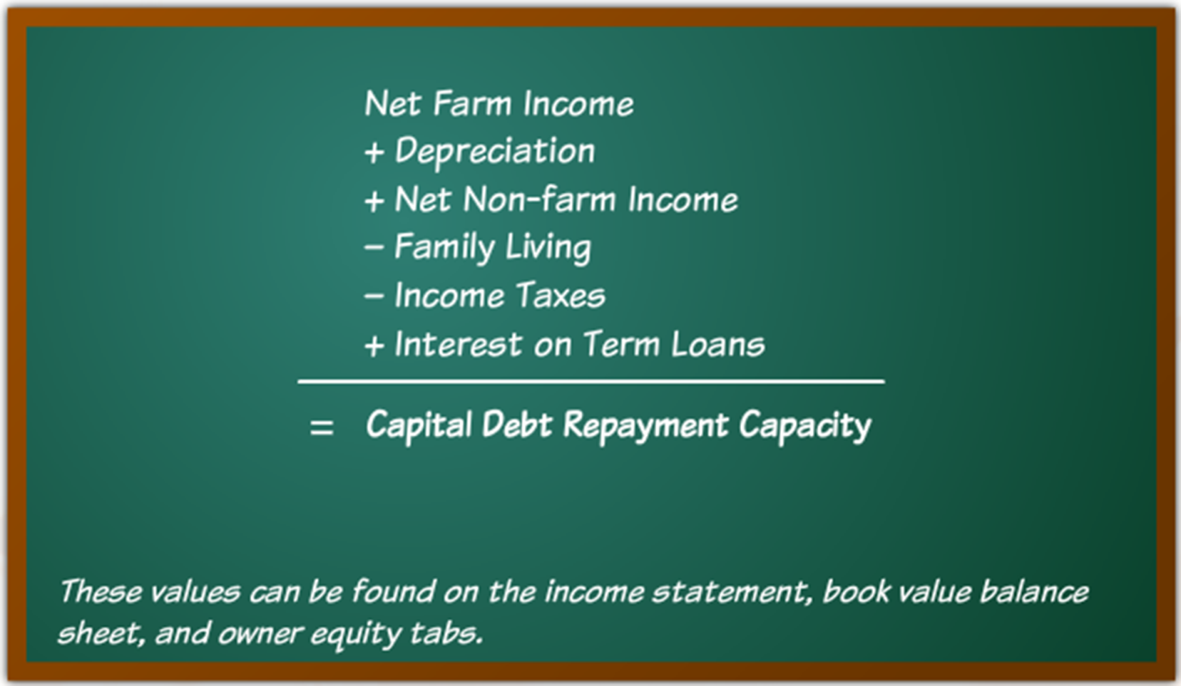
Measures of Repayment Capacity
Capital Debt Repayment Capacity
Notes:
Audio:
Capital Debt Repayment Capacity is calculated with the formula shown on screen.
These values can be found on the income statement, balance sheet, and family financial records.
The results of this calculation indicate the amount of funds available to cover debt and lease payments or to make alternative investments.

Slide 5
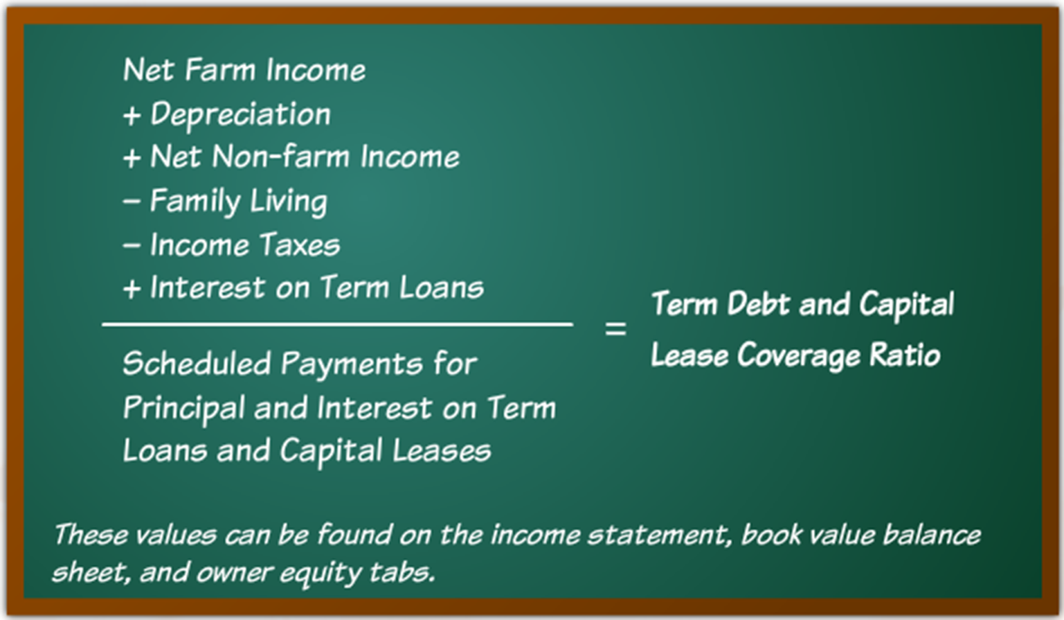
Measures of Repayment Capacity
Term Debt and Capital Lease Coverage
Notes:
Audio:
The Term Debt and Capital Lease Coverage ratio is calculated with the formula shown on screen.
These values can be found on the income statement, balance sheet, and family financial records.
The Term Debt and Capital Lease Coverage ratio measures the ability of the business to cover debt and lease payments, replace assets, or make alternative investments.

Slide 6
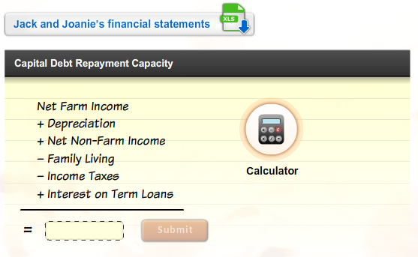
Measures of Repayment Capacity
Calculate the Ratios
Download Jack and Joanie’s financial statements. Then, calculate the capital debt repayment capacity. Click Submit to check
your answers.
Notes:
Audio:
Now, try calculating the ratios. Click on the link to download Jack and Joanie’s financial statements. Then, calculate Jack and Joanie’s capital debt repayment capacity. Click the calculator icon to access a calculator tool.
Click Submit to check your answer.

Slide 7
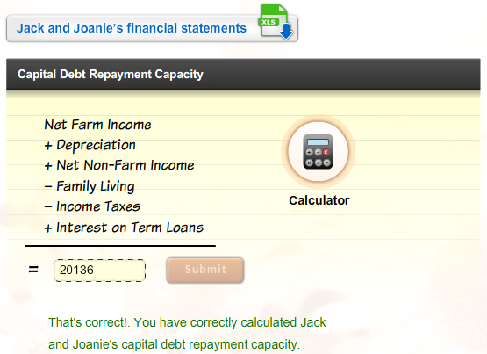
Measures of Repayment Capacity
Calculate the Ratios
Download Jack and Joanie’s financial statements. Then, calculate the capital debt repayment capacity. Click Submit to check
your answers.

Slide 8
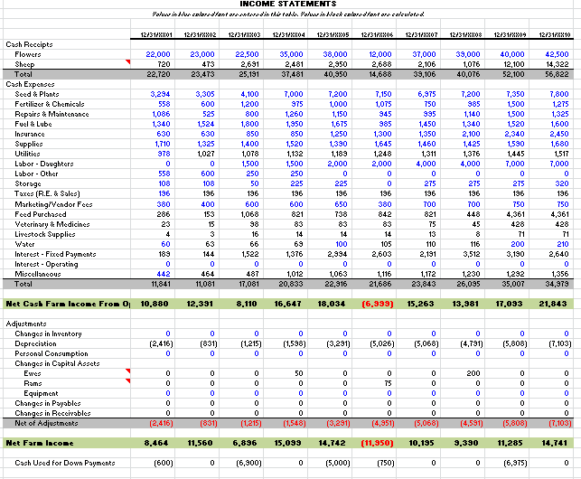
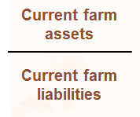

Measures of Repayment Capacity
Calculate the Ratios, Cont.
Calculate Jack and Joanie’s equity/asset ratio. Click Submit to check your answers.
Calculating Capital Debt Repayment Capacity X
Step 1:
Locate the net farm income value on Jack and Joanie’s income statement.
Current Ratio
=
1.75
That’s incorrect. Try again or click on the Hint icon for a little help.
SUBMIT
Next Slide

Slide 9
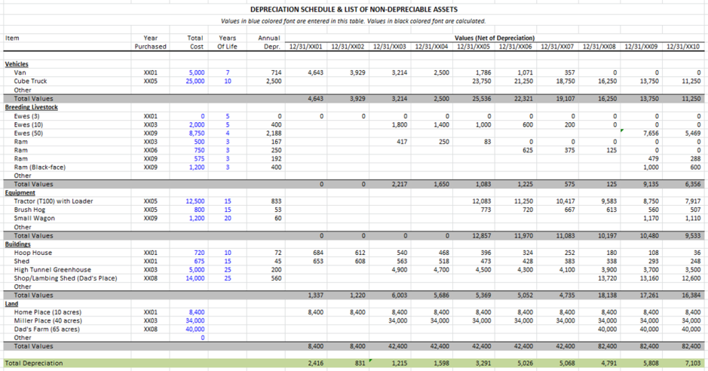
Measures of Repayment Capacity
Calculate the Ratios, Cont.
Calculate Jack and Joanie’s equity/asset ratio. Click Submit to check your answers.
Calculating Capital Debt Repayment Capacity X
Step 2:
Locate the total depreciation expense on Jack and Joanie’s depreciation schedule add it to the net farm income.
Current Ratio
14,741 + 7,103 = 21,844
=
1.75
That’s incorrect. Try again or click on the Hint icon for a little help.
SUBMIT
Next Slide

Slide 10
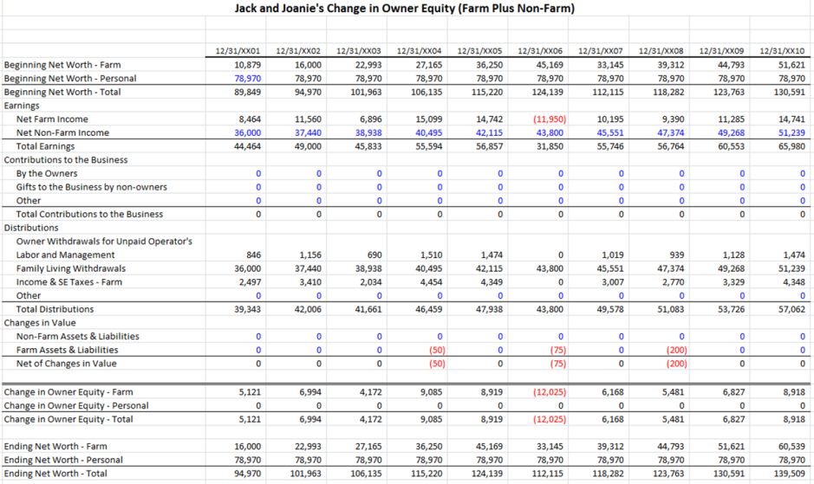
Measures of Repayment Capacity
Calculate the Ratios, Cont.
Calculate Jack and Joanie’s equity/asset ratio. Click Submit to check your answers.
Calculating Capital Debt Repayment Capacity X
Step 3:
Locate the non-farm income value on Jack and Joanie’s statement of owner equity and add that to the previous total.
Step 4:
Locate the total family living expenses on the statement of owner equity and subtract it from the result of Step 3.
Step 5:
Subtract the amount recorded for income taxes from the total.
Current Ratio
21,844 + 51,239 = 73,083
=
1.75
73,083 – 51,239 = 21,844
That’s incorrect. Try again or click on the Hint icon for a little help.
21,844 – 4,348 = 17,496
SUBMIT
Next Slide

Slide 11
Measures of Repayment Capacity
Calculate the Ratios, Cont.
Calculate Jack and Joanie’s equity/asset ratio. Click Submit to check your answers.
Calculating Capital Debt Repayment Capacity X
Step 6:
Add the amount for interest on long-term debts on Jack and Joanie’s income statement to arrive at the capital debt repayment capacity.
Current Ratio
17,496 + 2,640 = 20,136
=
1.75
That’s incorrect. Try again or click on the Hint icon for a little help.
SUBMIT

Slide 12
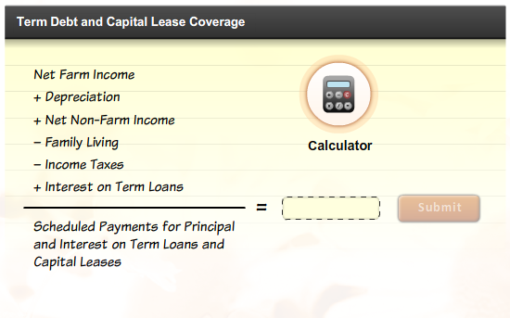
Measures of Repayment Capacity
Calculate the Ratios, Cont.
Calculate Jack and Joanie’s term debt and capital lease coverage ratio. Click Submit to check
your answers.
Notes:
Audio:
Now, try calculating Jack and Joanie’s term debt and capital lease coverage ratio using information from the income statement, book value balance sheet, and family financial records for example year 10.
Click the calculator icon to access a calculator tool.
Click Submit to check your answer.

Slide 13
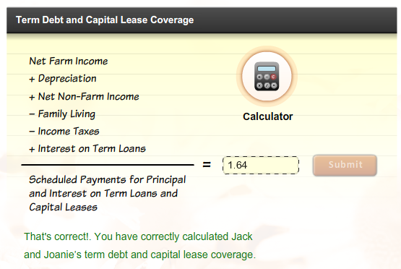
Measures of Repayment Capacity
Calculate the Ratios, Cont.
Calculate Jack and Joanie’s term debt and capital lease coverage ratio. Click Submit to check
your answers.

Slide 14
Measures of Repayment Capacity
Calculate the Ratios, Cont.
Calculate Jack and Joanie’s equity/asset ratio. Click Submit to check your answers.
Calculating Term Debt and Capital Lease Coverage Ratio X
Step 1:
Locate the net farm income value on Jack and Joanie’s income statement.
Current Ratio
=
1.75
That’s incorrect. Try again or click on the Hint icon for a little help.
SUBMIT
Next Slide

Slide 15
Measures of Repayment Capacity
Calculate the Ratios, Cont.
Calculate Jack and Joanie’s equity/asset ratio. Click Submit to check your answers.
Calculating Term Debt and Capital Lease Coverage Ratio X
Step 2:
Locate the total depreciation expense on Jack and Joanie’s depreciation schedule add it to the net farm income.
Current Ratio
14,741 + 7,103 = 21,844
=
1.75
That’s incorrect. Try again or click on the Hint icon for a little help.
SUBMIT
Next Slide

Slide 16
Measures of Repayment Capacity
Calculate the Ratios, Cont.
Calculate Jack and Joanie’s equity/asset ratio. Click Submit to check your answers.
Calculating Term Debt and Capital Lease Coverage Ratio X
Step 3:
Locate the non-farm income value on Jack and Joanie’s statement of owner equity and add that to the previous total.
Step 4:
Locate the total family living expenses on the statement of owner equity and subtract it from the result of Step 3.
Step 5:
Subtract the amount recorded for income taxes from the total.
Current Ratio
21,844 + 51,239 = 73,083
=
1.75
73,083 – 51,239 = 21,844
That’s incorrect. Try again or click on the Hint icon for a little help.
21,844 – 4,348 = 17,496
SUBMIT
Next Slide

Slide 17
Measures of Repayment Capacity
Calculate the Ratios, Cont.
Calculate Jack and Joanie’s equity/asset ratio. Click Submit to check your answers.
Calculating Term Debt and Capital Lease Coverage Ratio X
Step 6:
Add the amount for interest on long-term debts on Jack and Joanie’s income statement to arrive at the capital debt repayment capacity.
Current Ratio
17,496 + 2,640 = 20,136
=
1.75
That’s incorrect. Try again or click on the Hint icon for a little help.
SUBMIT
Next Slide

Slide 18
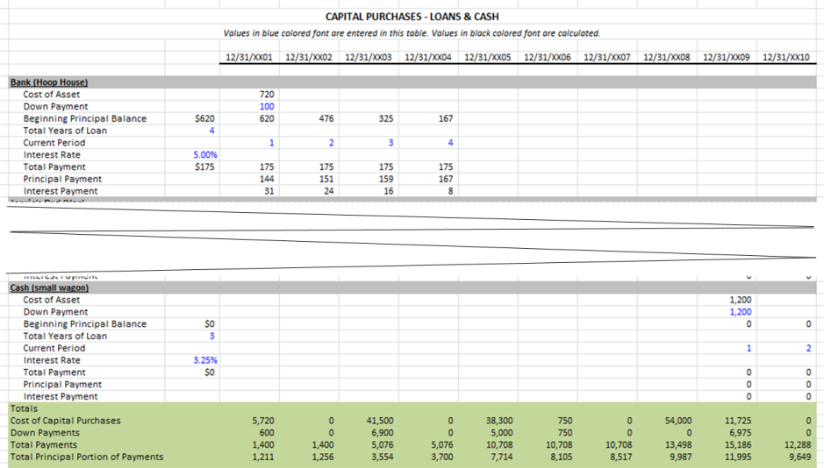
Measures of Repayment Capacity
Calculate the Ratios, Cont.
Calculate Jack and Joanie’s equity/asset ratio. Click Submit to check your answers.
Calculating Term Debt and Capital Lease Coverage Ratio X
Step 7:
Divide the capital debt repayment capacity by the scheduled payments for principal and interest on term loans and capital leases listed as total payments on Jack and Joanie’s Capital Purchases – Loans and Cash Worksheet.
Current Ratio
=
1.75
20,136
12,288
= 1.64
That’s incorrect. Try again or click on the Hint icon for a little help.
SUBMIT

Slide 19
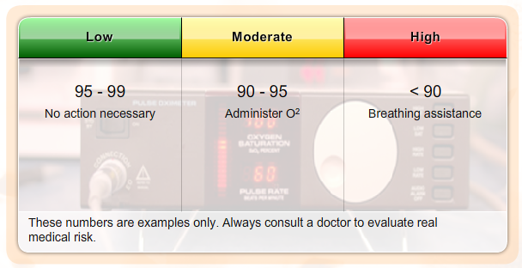
Measures of Repayment Capacity
Evaluating the Results
Financial ratios are most valuable when you have a value to compare them to. This might be your ratio calculations from previous years or industry benchmarks.
Benchmarks: oxygen saturation
Financial benchmarks work much the same way. Variations will occur between size of operations, owned versus leased, types of operation, location of operation, and other factors.
Notes:
Audio:
Financial ratios are most valuable when you have something to compare them to. This might be ratio calculations from previous years or industry benchmarks.
Benchmarks are guidelines or general rules of thumb related to a specific industry. For instance, a normal oxygen saturation level is between 95-99 percent. However, the level can vary with age, general health, and other variables. Thus, there is no single oxygen saturation percentage that can be considered normal. The benchmark range simply allows a doctor to interpret the measurement and to decide if further action is required.
Financial benchmarks work much the same way.

Slide 20
Measures of Repayment Capacity
Evaluating the Results
Financial ratios are most valuable when you have a value to compare them to. This might be your ratio calculations from previous years or industry benchmarks.
Benchmarks: oxygen saturation
Financial benchmarks work much the same way. Variations will occur between size of operations, owned versus leased, types of operation, location of operation, and other factors.
Benchmarks:
Guidelines or rules of thumb for the parameters that represent a “normal” state or situation. In financial benchmarks the “normal” state is dependent on a number of variables including the industry, market, and size/type of operation in which a particular result is generated.

Slide 21
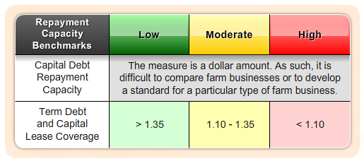
Measures of Repayment Capacity
Financial Efficiency Benchmarks
    Possible Actions For Improvement: Increase the value of production, reduce production costs where prudent, control or reduce family living withdrawals, improve marketing practices, properly structure debt to revenue generation.
Notes:
Audio:
Some benchmarks for financial efficiency ratio values are shown on screen.
The benchmarks are meant to be only a guideline for comparison purposes.
The correlated benchmarks are presented in terms of green, yellow, and red lights. A green light represents a financial strength with low risk. A yellow light corresponds to moderate risk, and a red light means weakness and high risk. A green light doesn’t guarantee success, nor does a red light imply failure. A weakness in one area may be overcome by strengths in other areas.
Each farm operator should establish specific benchmarks for their specific farm operation.

Slide 22
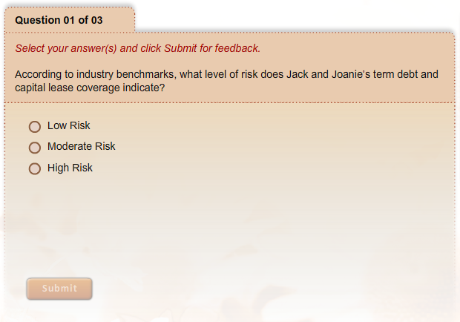
Measures of Repayment Capacity
What Have You Learned?
Notes:
Audio:
Check what you have learned about measures of repayment capacity by answering the questions on screen. Click Submit to check your answers.

Slide 23
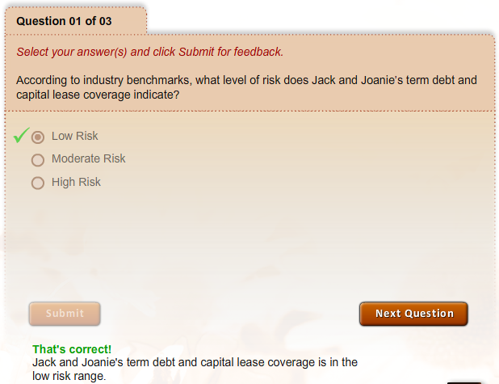
Measures of Repayment Capacity
What Have You Learned?

Slide 24
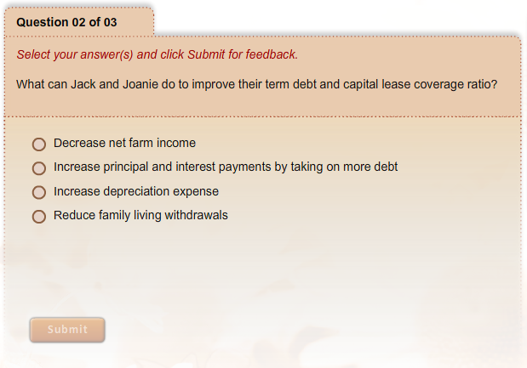
Measures of Repayment Capacity
What Have You Learned?

Slide 25
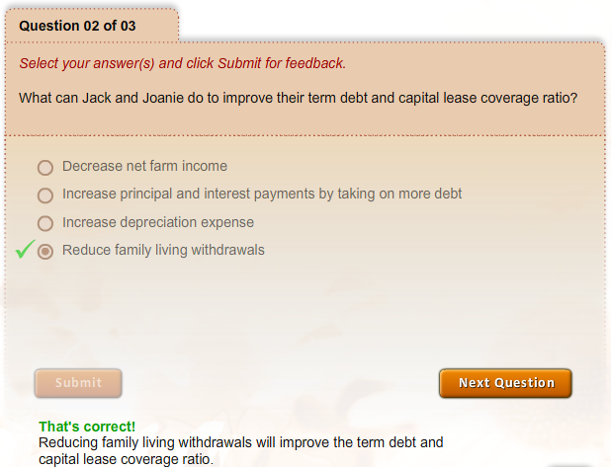
Measures of Repayment Capacity
What Have You Learned?

Slide 26
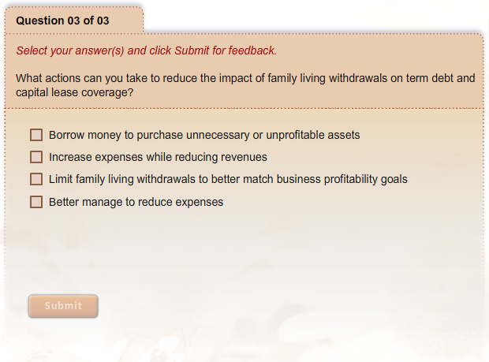
Measures of Repayment Capacity
What Have You Learned?

Slide 27
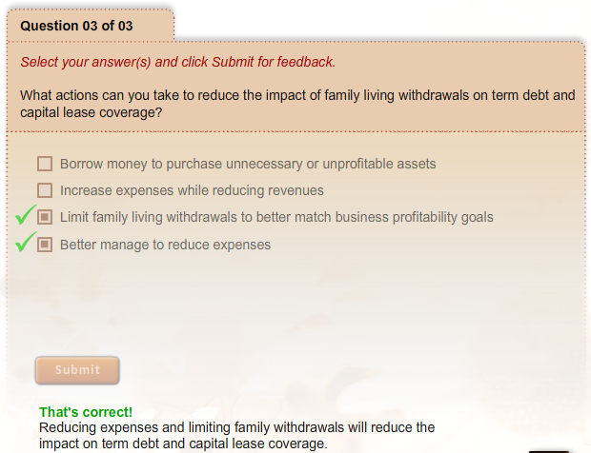
Measures of Repayment Capacity
What Have You Learned?

