Slide 1
Understanding Financial Performance
Getting on Track Authors: Rodney L. Sharp, John P. Hewlett, Jeffrey E. Tranel
Notes:
Audio:
Welcome to Getting on Track: Understanding Financial Performance. In this course you will learn how to analyze the health of your business using financial ratios.
Click the next arrow to start at the beginning of the course or click the Menu link to select a lesson from the Main Menu. We recommend that you view the lessons in order the first time through the course.

Slide 2
Where Do We Go From Here?
Lesson 8

Slide 3
Where Do We Go From Here?
Trend Analysis
I’m glad that we took the time to do some financial analysis. I learned a lot about how the business is performing that I didn’t realize before and we now have a plan for how to improve our performance in the future.

Slide 4
Where Do We Go From Here?
Trend Analysis
I agree, but I am wondering how we will know if the actions we take to improve our financial performance actually work.

Slide 5
Where Do We Go From Here?
Trend Analysis
Well, if you and Joanie continue to monitor some key ratios for several years, you can do a trend analysis to determine if your actions are having the effect you intended.

Slide 6
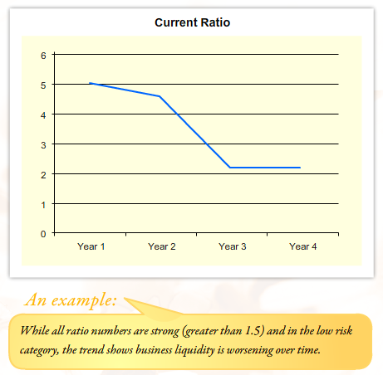
Where Do We Go From Here?
Trend Analysis
Notes:
Audio:
Individual ratio measurements provide insight into financial performance, but trends in the ratios are even more useful.
A trend is a direction or tendency a ratio exhibits after two or more years.
Monitoring trends can provide a warning system if the ratios are worsening or validate the effectiveness of your decisions and actions if the ratios are improving.
Erratic financial performance should also be watched as it may indicate a sign of instability due to management problems or other factors.

Slide 7
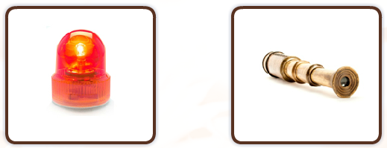
Where Do We Go From Here?
Benefits of Trend Analysis
Provides an early warning system when financial performance is worsening so that you can take action before the business is at risk.
Provides insight into the financial effects of your business management decisions and practices.
Notes:
Audio:
Monitoring trends can provide a warning system when financial performance is worsening so adjustments can be made before ratios go into the moderate or high risk range.
This allows you to take action to reverse a trend before the business is at risk.
Also, trend analysis allows you to see the effects of your management decisions and practices on the financial performance of your business. This will make you a better business manager over time.

Slide 8
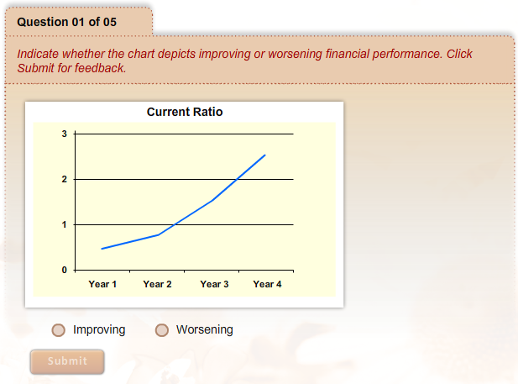
Where Do We Go From Here?
Analyzing Trends
Indicate whether the chart depicts improving or worsening financial performance. Click Submit for feedback.
Notes:
Audio:
Let’s practice analyzing trends. Review the graphs shown and indicate whether they depict performance that is improving or worsening.
Click Submit to receive feedback.

Slide 9
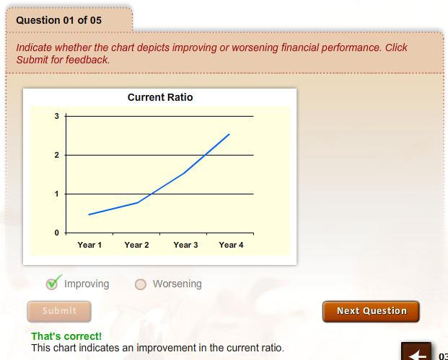
Where Do We Go From Here?
Analyzing Trends
Indicate whether the chart depicts improving or worsening financial performance. Click Submit for feedback.

Slide 10
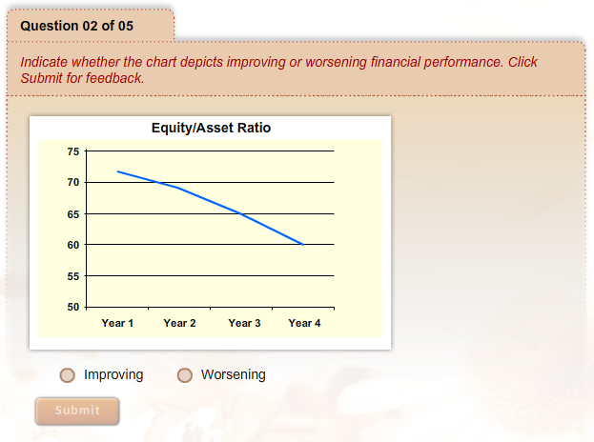
Where Do We Go From Here?
Analyzing Trends
Indicate whether the chart depicts improving or worsening financial performance. Click Submit for feedback.

Slide 11
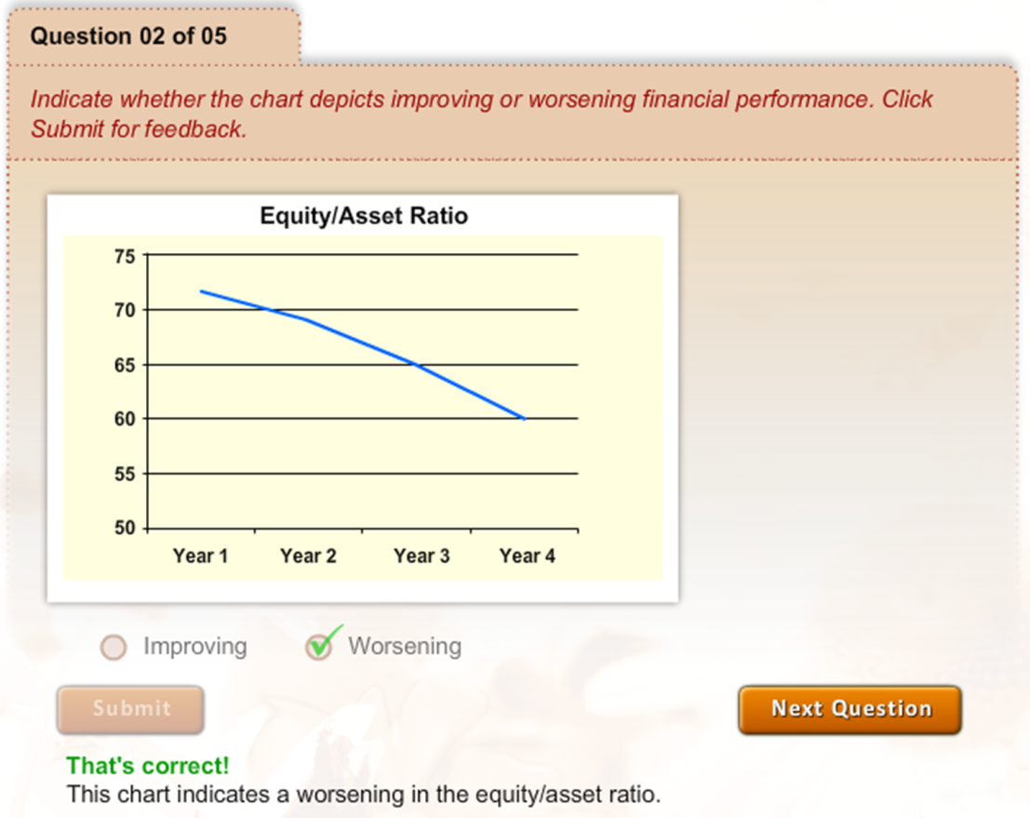
Where Do We Go From Here?
Analyzing Trends
Indicate whether the chart depicts improving or worsening financial performance. Click Submit for feedback.

Slide 12
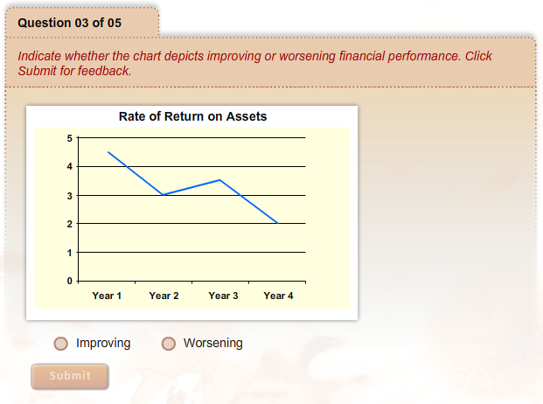
Where Do We Go From Here?
Analyzing Trends
Indicate whether the chart depicts improving or worsening financial performance. Click Submit for feedback.

Slide 13
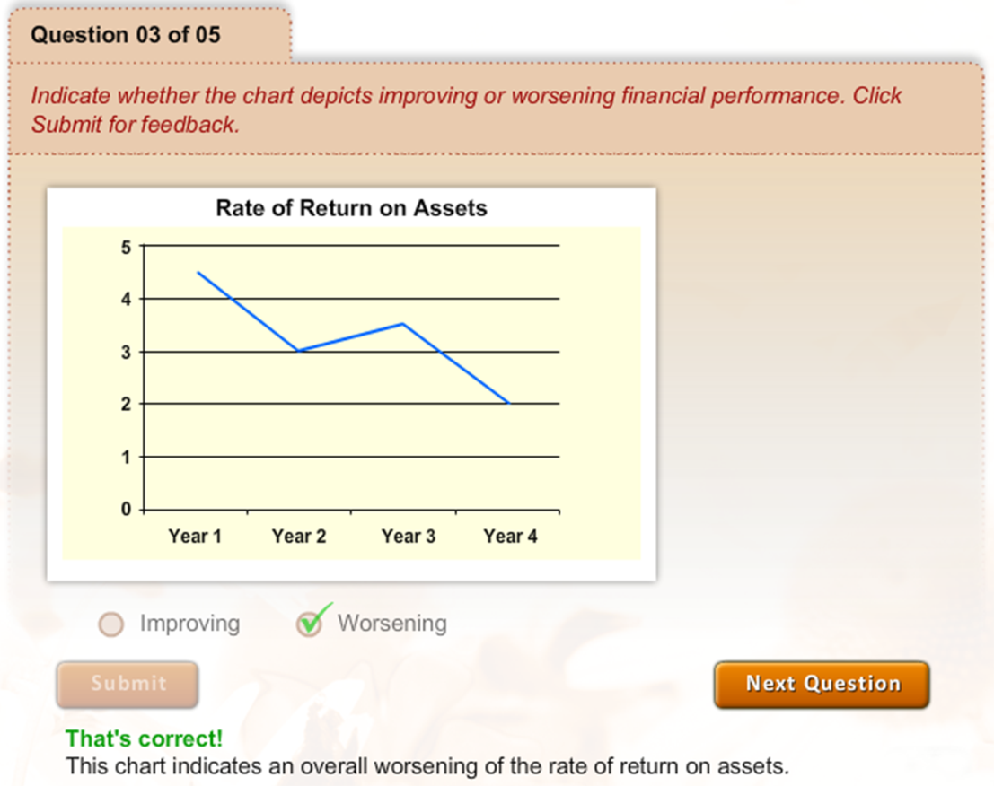
Where Do We Go From Here?
Analyzing Trends
Indicate whether the chart depicts improving or worsening financial performance. Click Submit for feedback.

Slide 14
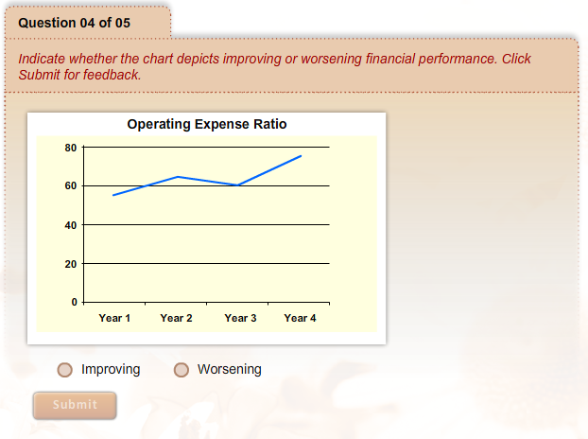
Where Do We Go From Here?
Analyzing Trends
Indicate whether the chart depicts improving or worsening financial performance. Click Submit for feedback.

Slide 15
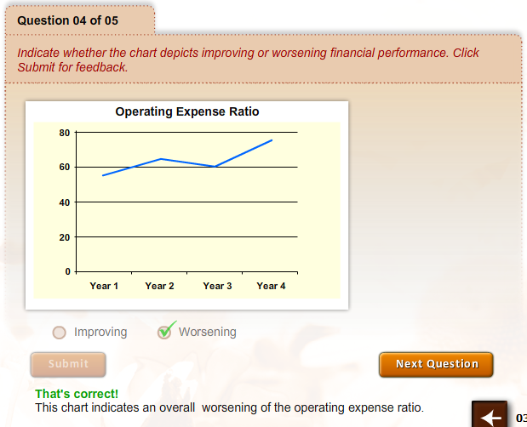
Where Do We Go From Here?
Analyzing Trends
Indicate whether the chart depicts improving or worsening financial performance. Click Submit for feedback.

Slide 16
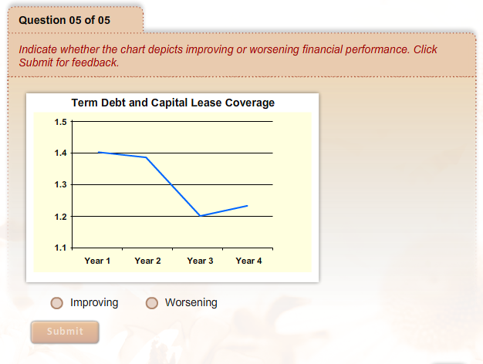
Where Do We Go From Here?
Analyzing Trends
Indicate whether the chart depicts improving or worsening financial performance. Click Submit for feedback.

Slide 17
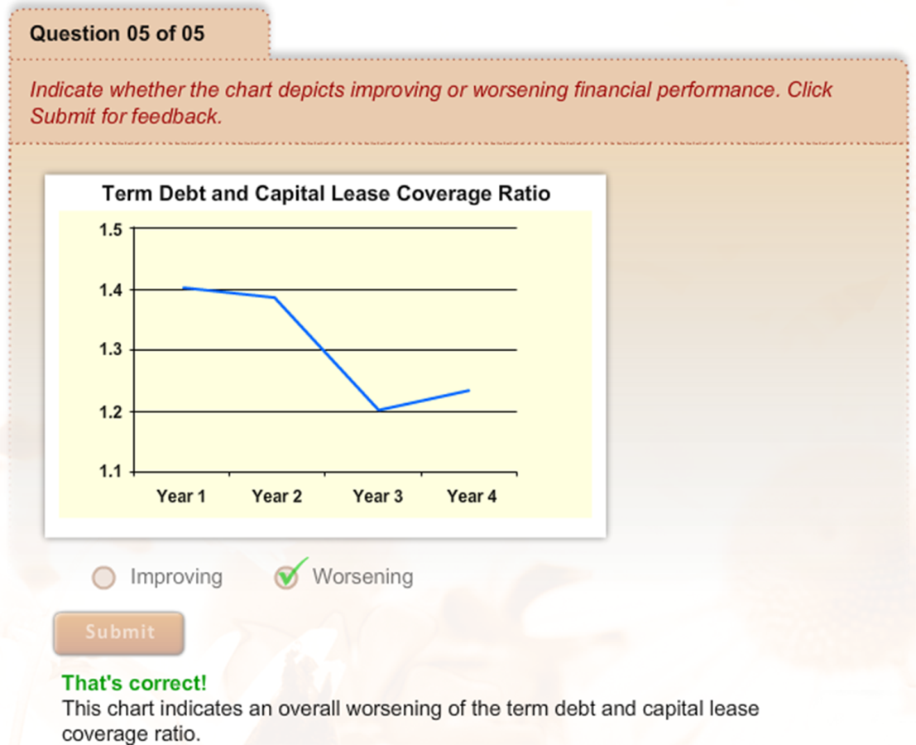
Where Do We Go From Here?
Analyzing Trends
Indicate whether the chart depicts improving or worsening financial performance. Click Submit for feedback.

Slide 18
Where Do We Go From Here?
Key Points to Remember
The financial health of a business is measured by looking at liquidity, solvency, profitability, financial efficiency, and repayment capacity.
Values in your financial records and statements can be used to calculate financial ratios measured in these five areas.
The results of financial ratio calculations are most useful when compared to industry benchmarks or historical values.
If you monitor financial ratios over a period of years, you can begin to identify financial trends in your business.
Performing this type of financial analysis can help you make better decisions and become a better manager of your business.
Notes:
Audio:
You have completed this course. Review the key points on the screen and then click the Next button for additional resources for financial management of your business.

Slide 19
Where Do We Go From Here?
Additional Resources
Other RightRisk courses that may be helpful to you include:
Feasibility of Alternative Rural Enterprises
Taxes for Agricultural Enterprises
Getting on Track: Better Management Through Basic Ag Records
Getting on Track: Better Management Through Basic Financial Statements
You can access the RightRisk web site at www.rightrisk.org.
Notes:
Audio:
This course has been produced by RightRisk. RightRisk has developed a number of courses to help people learn how to better manage their ag businesses. The RightRisk web site contains other courses and resources for new, beginning, and existing farmers and ranchers.

